Slide 1

CFD Code V&V: 2D NACA 0012 in Stall
Vérification et Validation en Modélisation Numérique
Project
David Vidal
S. Paquette-Greenbaum, R. Zachariah, & K. A. N. Lippert
April 15th 2024
https://github.com/karolali22/MEC8211_PROJECT

Slide 2

MODEL & DISCRETIZATION
This V&V procedure makes use of the Chapel-Multiphysics (CHAMPS) in-house CFD code. CHAMPS is a CFD code developed in Eric Laurendeau’s laboratory. Eric Laurendeau is professor at Polytechnique Montréal in the Department of Mechanical Engineering. The Unsteady Reynolds Averaged Navier-Stokes (URANS) equations are solved in this procedure to determine the model’s adequacy in the context of a reference case described in:
NASA Technical Memorandum 4074: C. L. Ladson, "NASA Technical Memorandum: Effects of independent variation of Mach and Reynolds numbers on the low-speed aerodynamic characteristics of the NACA 0012 airfoil section“, 1988. [Online]. Available: https://api.semanticscholar.org/CorpusID:117770433
The model utilized in the V&V procedure is configured as follows to solve the URANS equations:
Convective scheme: 1st – order upwind Roe scheme (Flux-Difference Splitting)
Turbulent viscosity model: Spalart-Allmaras model
Temporal scheme: Time-Spectral method (Fourier series to transform the URANS equations into a steady problem in the frequency domain)
Convergence criteria: 10⁻⁵ for density
Mesh: O-meshes with varying mesh refinement, viscous wall and farfield boundary conditions
The selected experimental reference case has the following nominal parameters:
Geometry: NACA 0012 airfoil
Reynolds number: Re = 5.970 × 10⁶
Mach number: M = 0.15
Angle of attack: α = [-4.05, -2.00, 0.05, 1.98, 4.18, 6.20, 8.22, 10.18, 11.08, 12.25, 13.10, 14.28, 15.20, 16.18, 16.9, 17.35, 17.65, 18.65]°
Surface roughness: ε = 0

Slide 3
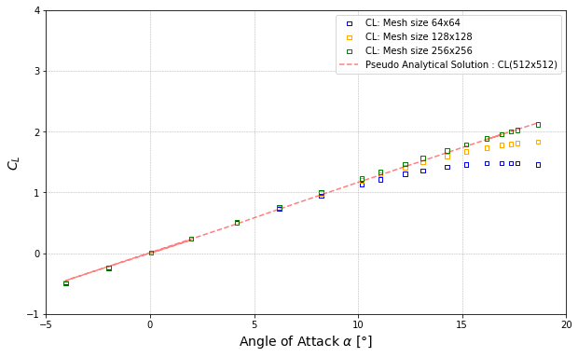
CODE VERIFICATION
System Response Quantities for coarse, medium and fine mesh have been recorded for mesh sizes as mentioned below:
Coarse Mesh : 64 x 64
Medium Mesh : 128 x 128
Fine Mesh : 256 x 256
Experimental data obtained for mesh dimension 512 x 512 is considered as the pseudo-analytical solution for code verification. It can be observed that the finer mesh SRQ (256 x 256) is the closest to the pseudo-analytical data. Further analysis shows that the observed order of convergence is in agreement with the formal order of 1.

Slide 4
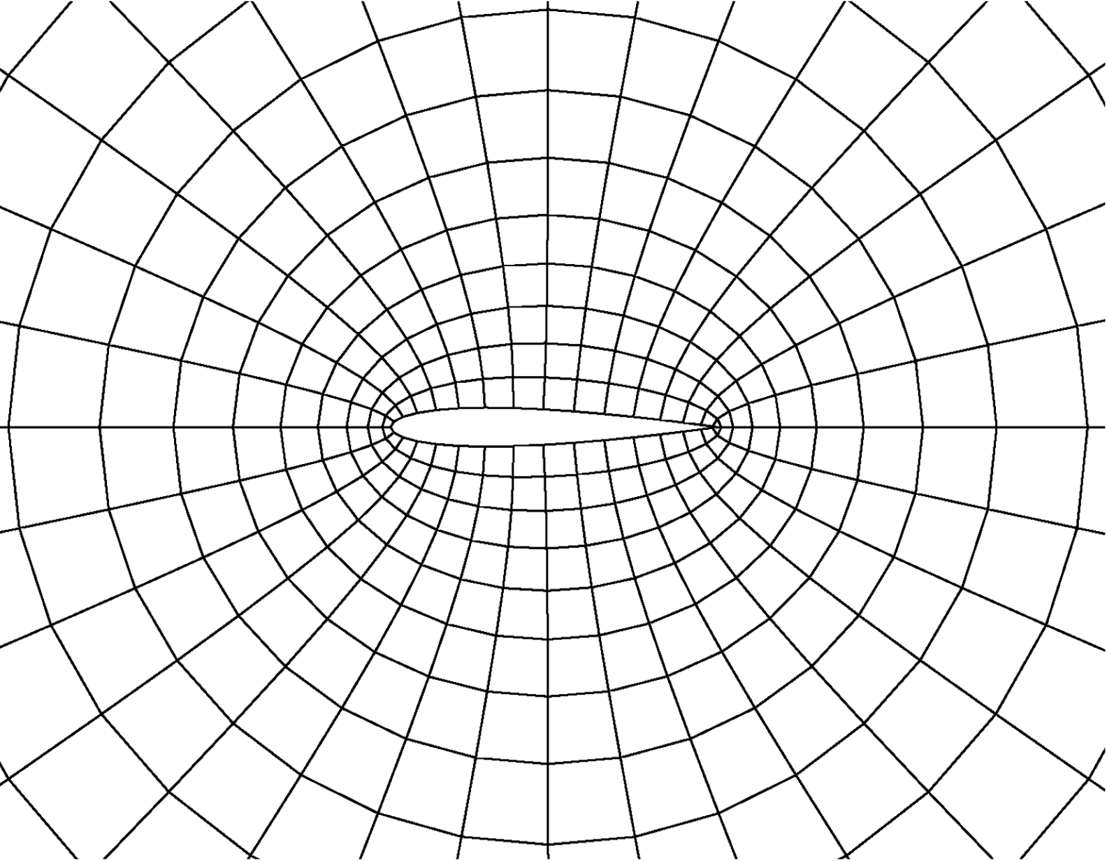
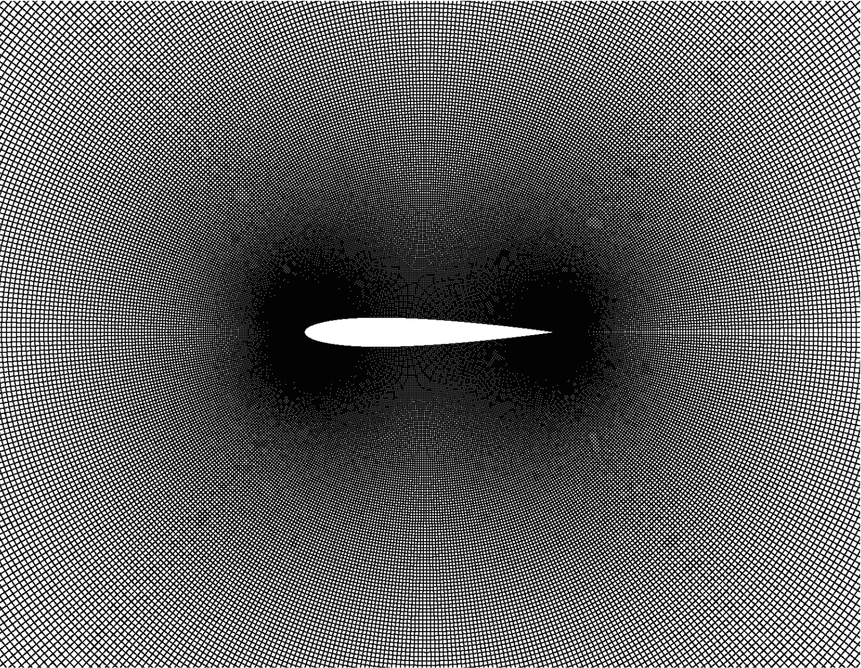
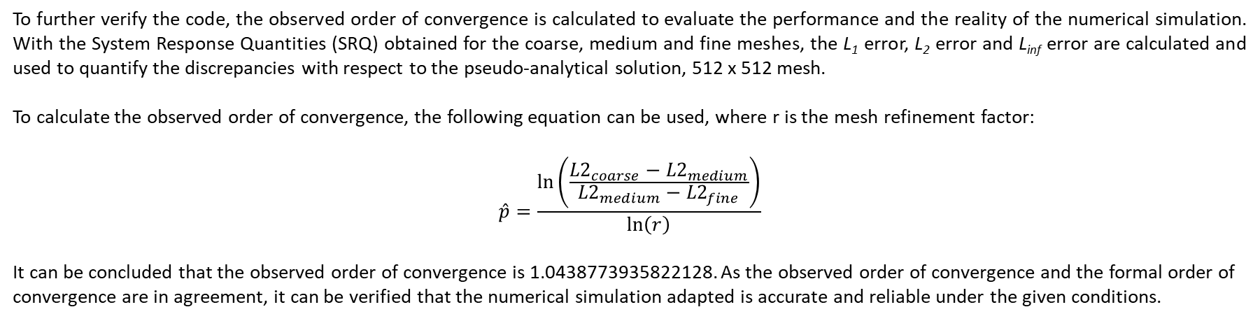
CONTINUED: CODE VERIFICATION
To further verify the code, the observed order of convergence is calculated to evaluate the performance and the reality of the numerical simulation. With the System Response Quantities (SRQ) obtained for the coarse, medium and fine meshes, the L₁ error, L₂ error and L_{inf} error are calculated and used to quantify the discrepancies with respect to the pseudo-analytical solution, 512 x 512 mesh.
To calculate the observed order of convergence, the following equation can be used, where r is the mesh refinement factor:
$$\hat{p}=\frac{\ln\left(\frac{{L2}_{coarse}−{L2}_{medium}}{{L2}_{medium}−{L2}_{fine}}\right)}{\ln\left(r\right)}$$
It can be concluded that the observed order of convergence is 1.0438773935822128. As the observed order of convergence and the formal order of convergence are in agreement, it can be verified that the numerical simulation adapted is accurate and reliable under the given conditions.

Slide 5
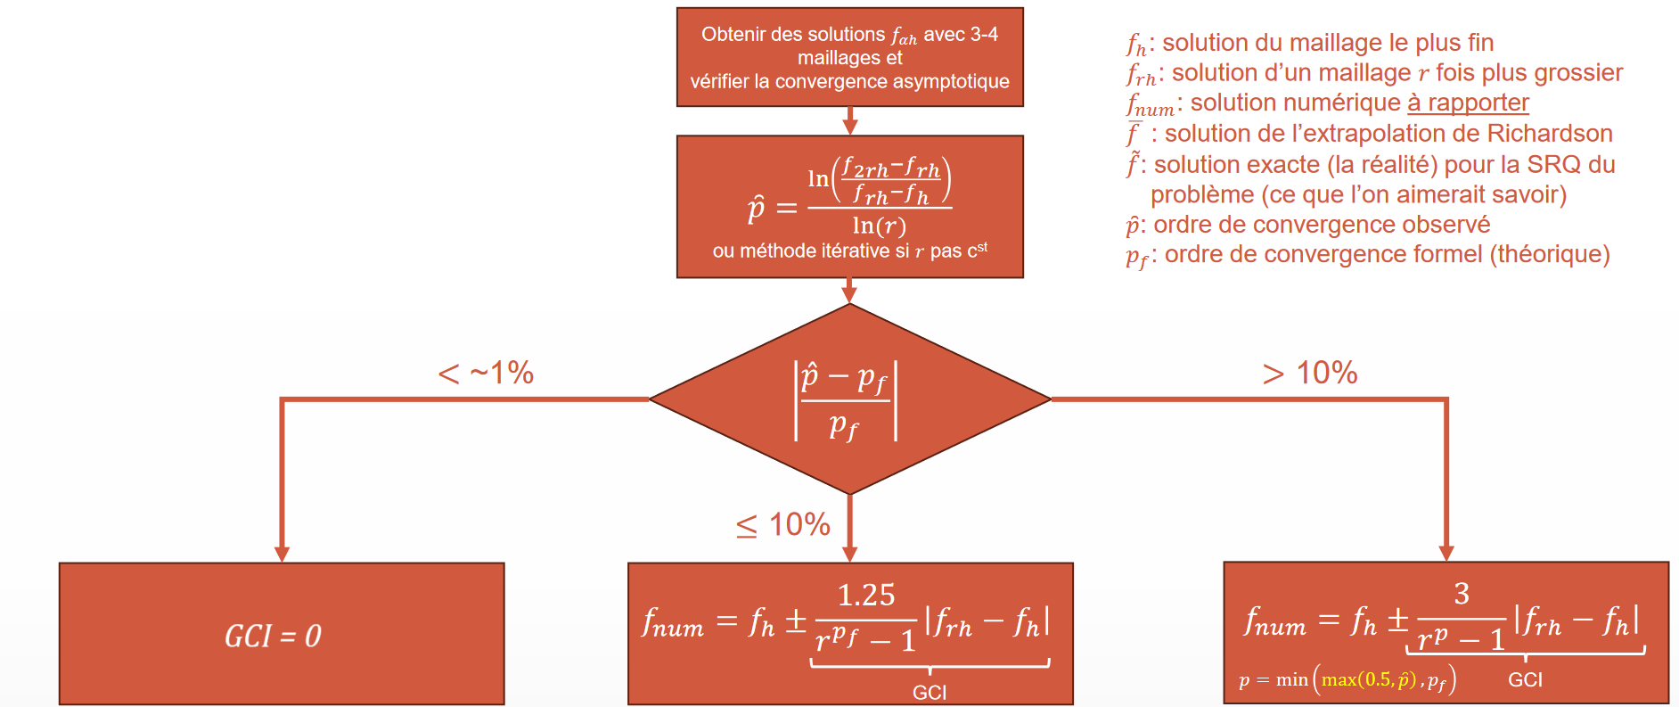
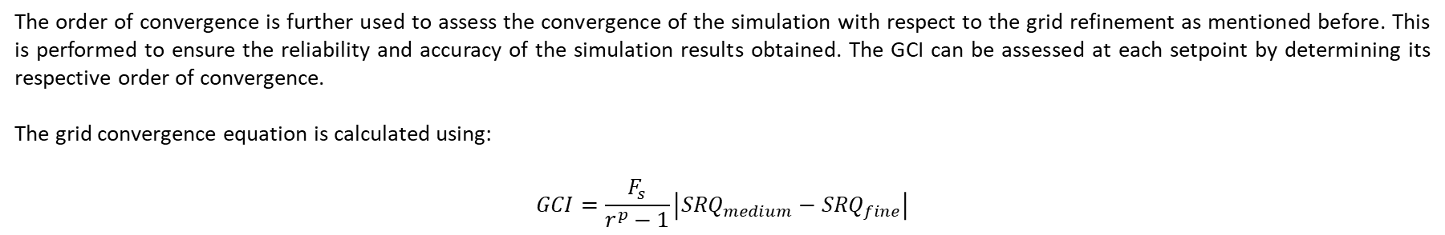
NUMERICAL UNCERTAINTY – u_{num}
The order of convergence is further used to assess the convergence of the simulation with respect to the grid refinement as mentioned before. This is performed to ensure the reliability and accuracy of the simulation results obtained. The GCI can be assessed at each setpoint by determining its respective order of convergence.​
The grid convergence equation is calculated using:
$$GCI=\frac{F_{s}}{r^{p}−1}\left|{SRQ}_{medium}−{SRQ}_{fine}\right|$$
Image 1: GCI Flowchart Summary. David Vidal. MEC8211 – Vérification de code.

Slide 6
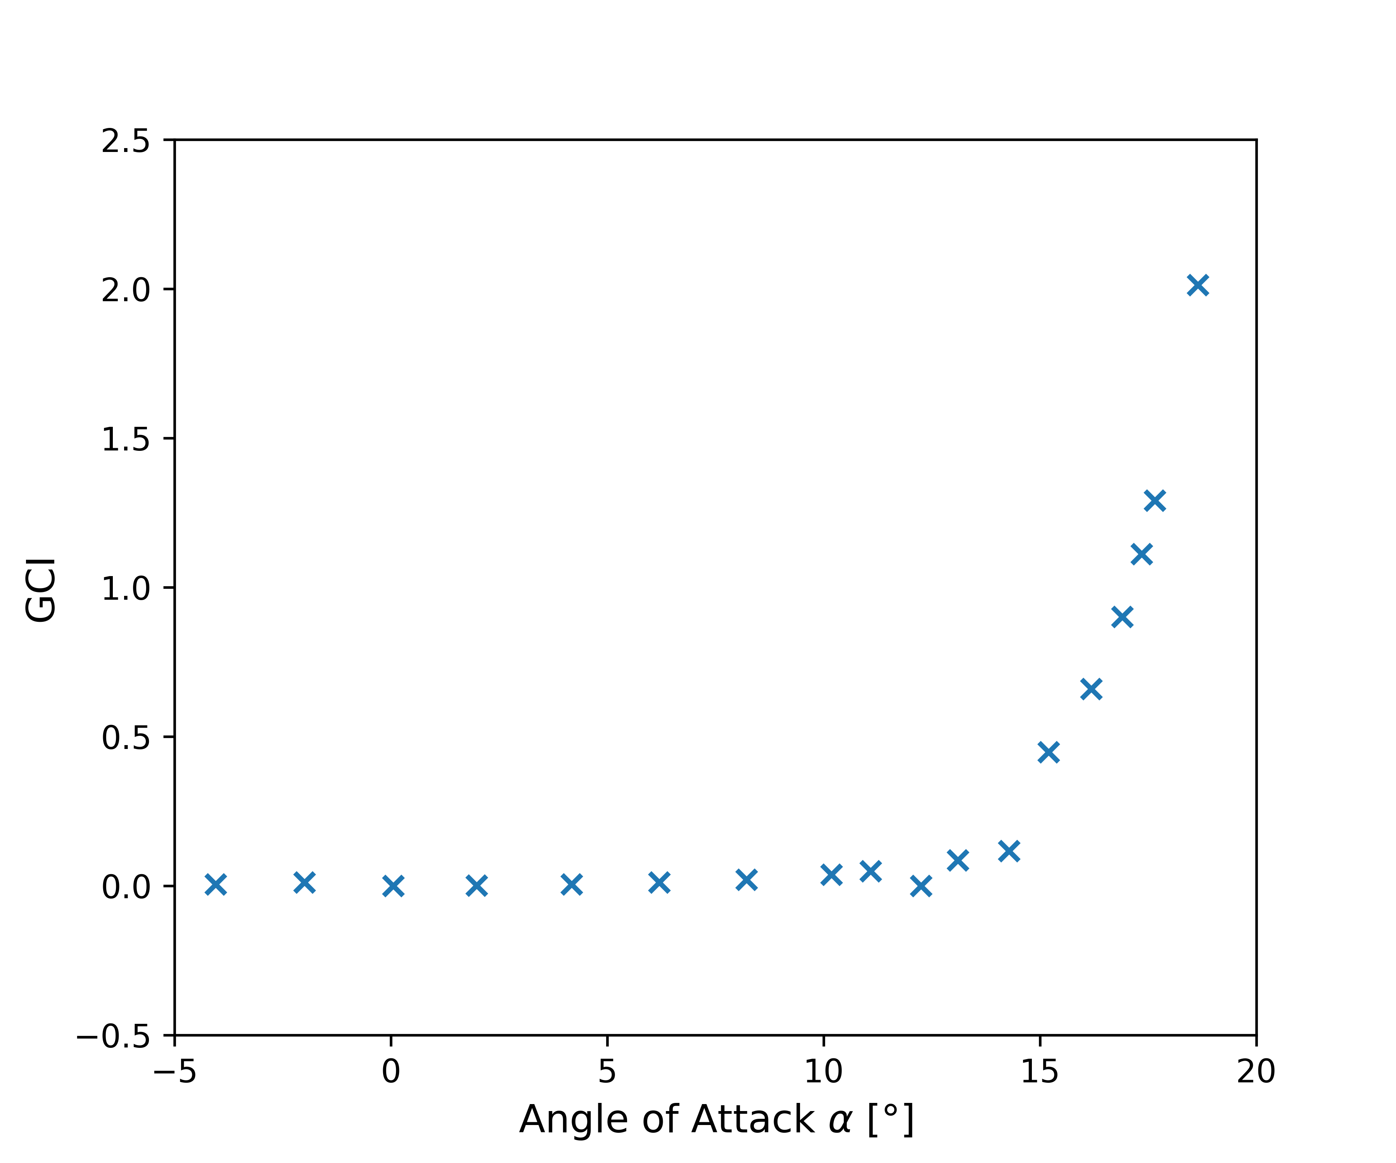
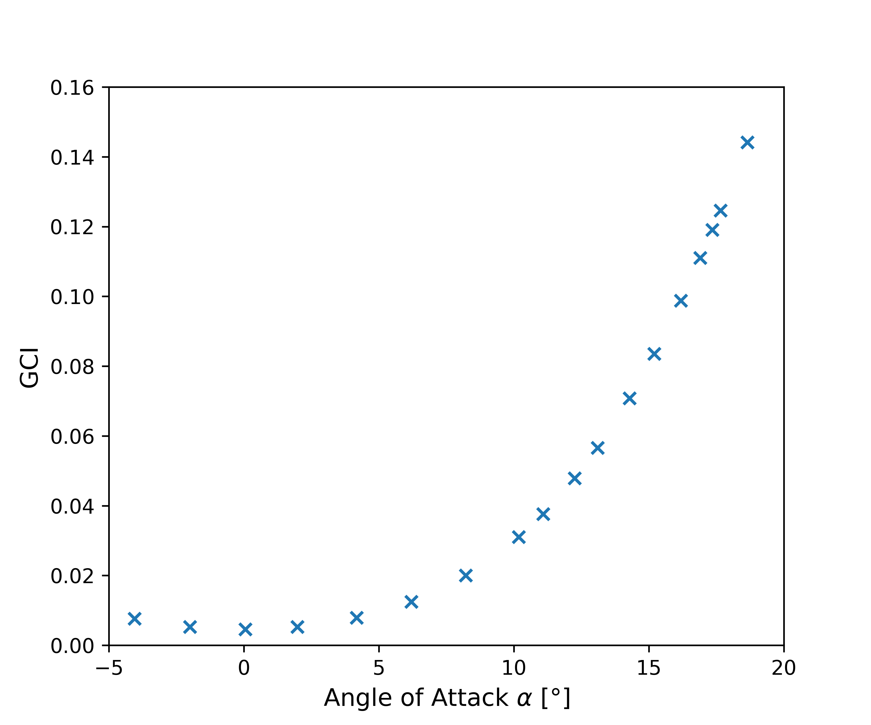
CONTINUED: NUMERICAL UNCERTAINTY – u_{num}
The variation of GCI in function of setpoint is shown in the figure below. It can be seen that GCI for both C_{L} and C_{D} SRQs increase in function of angle of attack. The increase in GCI denotes how well the solution has converged as the grid is refined. The increase in GCI is seen nearer to the region of stall, indicating that there is greater numerical uncertainty at higher angles of attack.
C_{L}
C_{D}

Slide 7
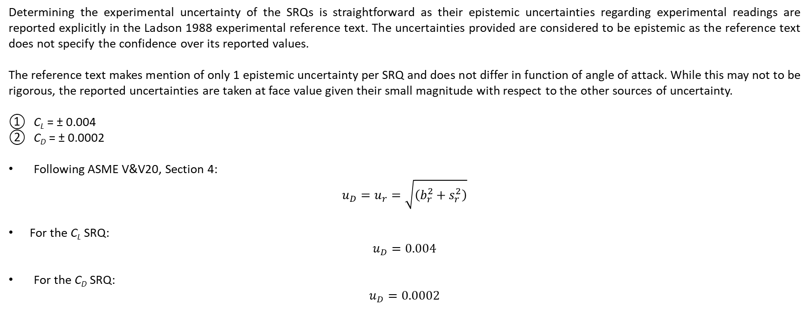
EXPERIMENTAL UNCERTAINTY – u_{D}
Determining the experimental uncertainty of the SRQs is straightforward as their epistemic uncertainties regarding experimental readings are reported explicitly in the Ladson 1988 experimental reference text. The uncertainties provided are considered to be epistemic as the reference text does not specify the confidence over its reported values.
The reference text makes mention of only 1 epistemic uncertainty per SRQ and does not differ in function of angle of attack. While this may not to be rigorous, the reported uncertainties are taken at face value given their small magnitude with respect to the other sources of uncertainty.
C_{L} = ± 0.004
C_{D} = ± 0.0002
Following ASME V&V20, Section 4:
$$u_{D}=u_{r}=\sqrt{\left(b_{r}^{2}+s_{r}^{2}\right)}$$
For the C_{L} SRQ:
$$u_{D}=0.004$$
For the C_{D} SRQ:
$$u_{D}=0.0002$$

Slide 8
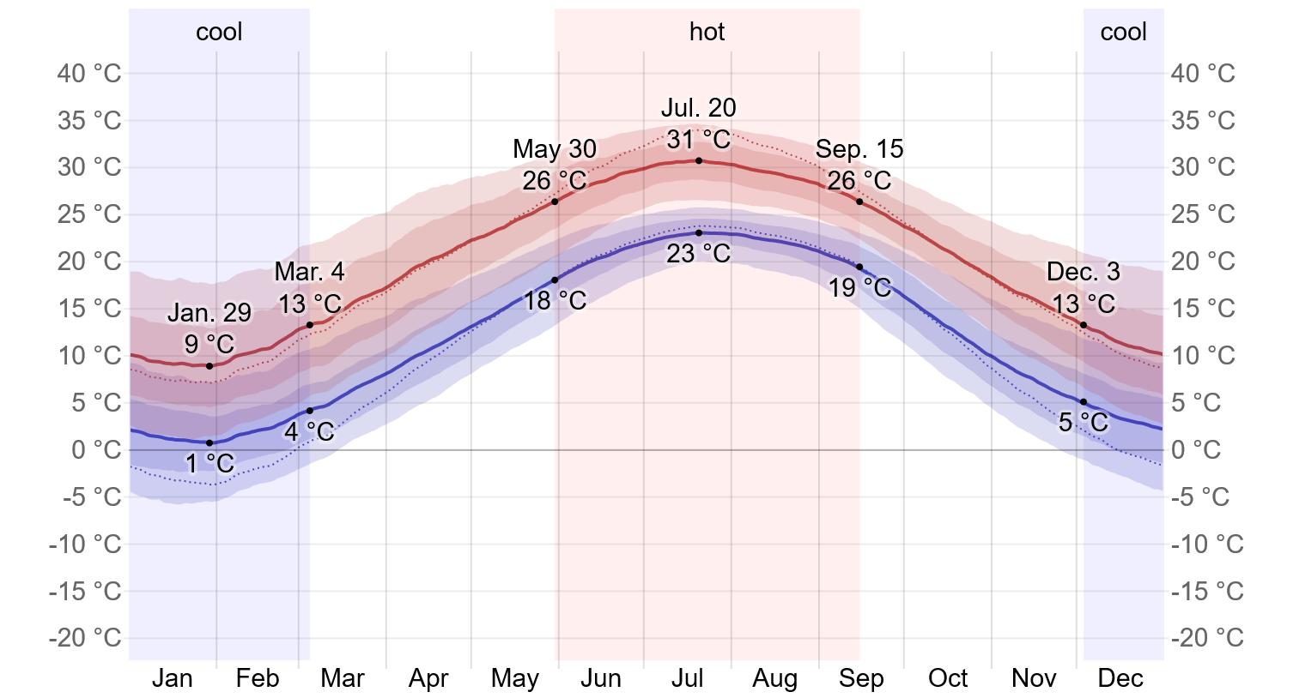
INPUT UNCERTAINTY – u_{input}
Input uncertainty in this validation procedure is determined via the propagation of uncertainty in the context of a Monte-Carlo Simulation (MCS). The Ladson 1988 experimental reference text does not specify input uncertainties for its experiments. For that reason, input uncertainties are either inferred when possible, or arbitrarily chosen when applicable.
The Langley Research Center is located in Hampton, Virginia, and historically experiences yearly respective high and low temperatures of 31 and 1 °C. The range of possible Reynolds numbers can be inferred from this fact given that wind tunnel apparatus is said to be kept at “near ambient conditions”. Angle of attack and Mach number are arbitrarily chosen to be normally distributed around their means for each setpoint. For simplicity, no uncertainty is attributed to the surface roughness input given its distribution’s log-normal nature. This uncertainty will be included in model error.
Epistemic uncertainty for Reynolds number: Re ∈ [5.591, 6.725] × 10⁶
Aleatory uncertainty for Mach number: M ≡ ( μ = 0.15 & σ = 0.015 )
Aleatory uncertainty for Angle of attack: α ≡ ( μ varies with setpoint & σ = 0.75° )
No uncertainty for surface roughness: ε = 0
Image 2: Hampton, Virginia Yearly Weather. WeatherSpark. https://weatherspark.com

Slide 9
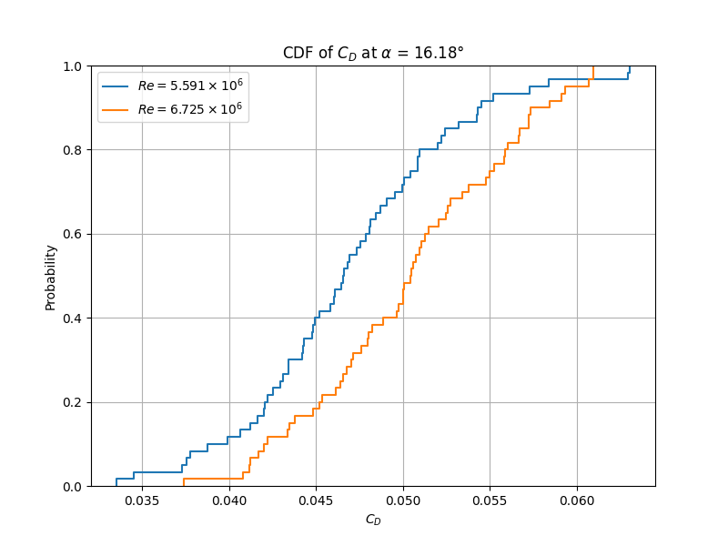
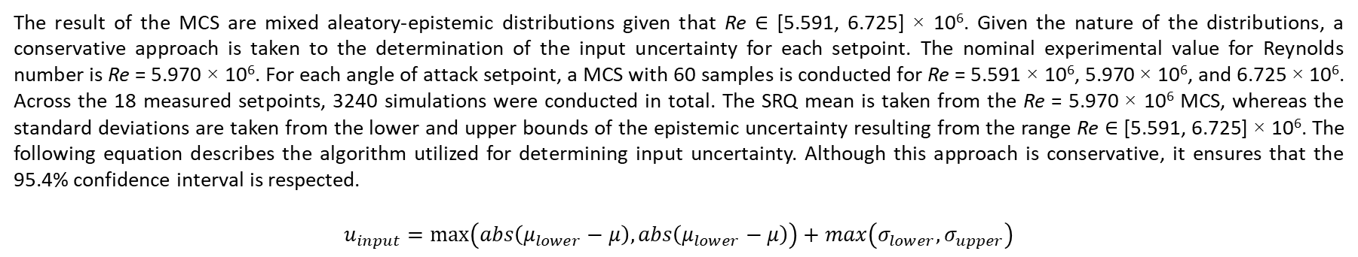
CONTINUED: INPUT UNCERTAINTY – u_{input}
The result of the MCS are mixed aleatory-epistemic distributions given that Re ∈ [5.591, 6.725] × 10⁶. Given the nature of the distributions, a conservative approach is taken to the determination of the input uncertainty for each setpoint. The nominal experimental value for Reynolds number is Re = 5.970 × 10⁶. For each angle of attack setpoint, a MCS with 60 samples is conducted for Re = 5.591 × 10⁶, 5.970 × 10⁶, and 6.725 × 10⁶. Across the 18 measured setpoints, 3240 simulations were conducted in total. The SRQ mean is taken from the Re = 5.970 × 10⁶ MCS, whereas the standard deviations are taken from the lower and upper bounds of the epistemic uncertainty resulting from the range Re ∈ [5.591, 6.725] × 10⁶. The following equation describes the algorithm utilized for determining input uncertainty. Although this approach is conservative, it ensures that the 95.4% confidence interval is respected.
$$u_{input}=\max\left(abs\left(μ_{lower}−μ\right),abs\left(μ_{lower}−μ\right)\right)+max\left(σ_{lower},σ_{upper}\right)$$

Slide 10
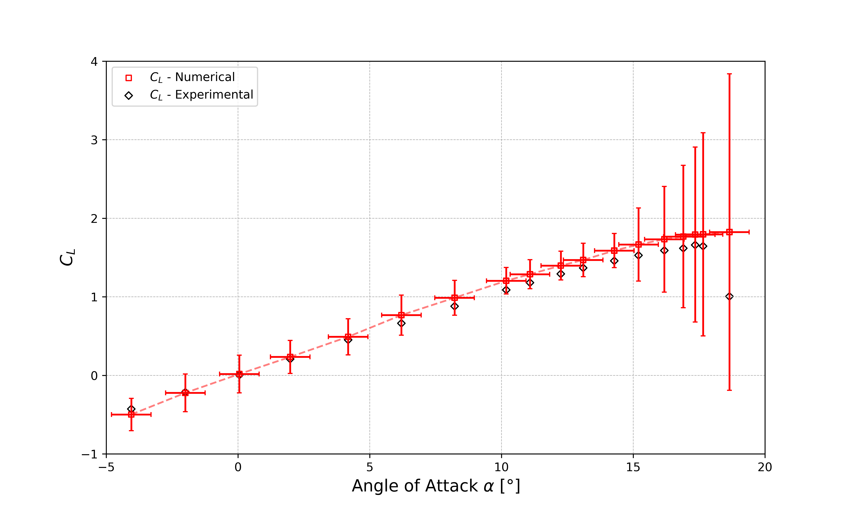
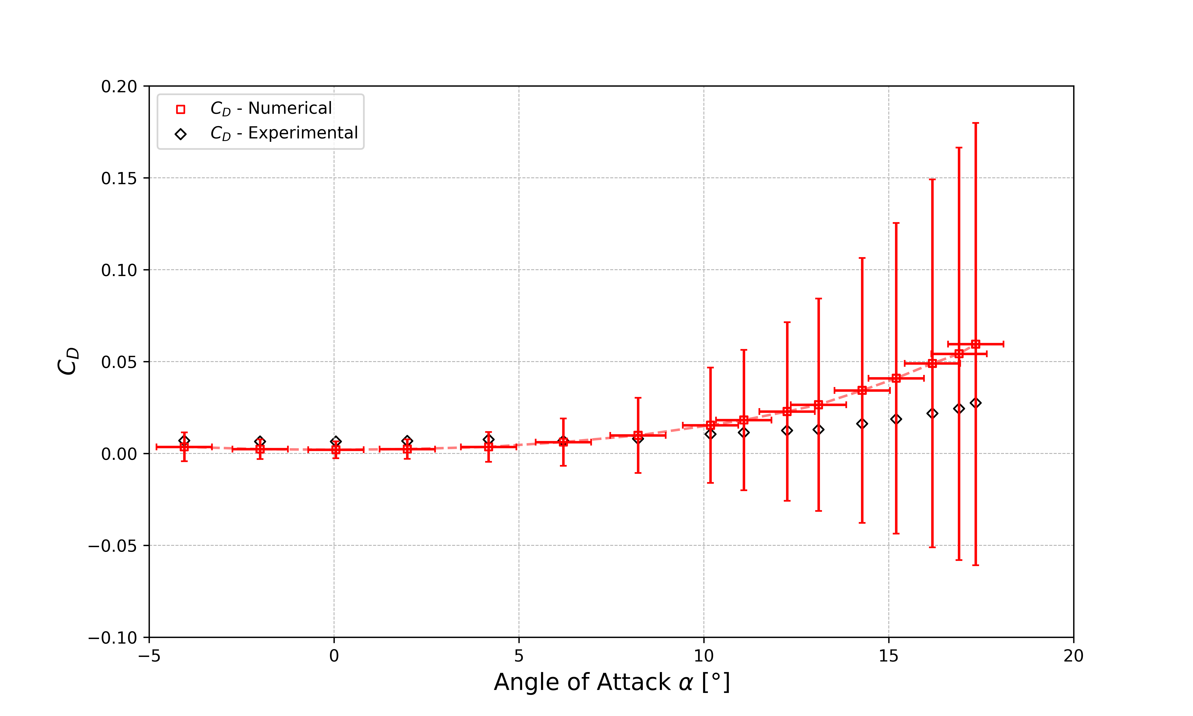
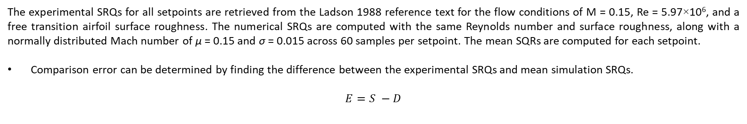
COMPARISON ERROR – E
The experimental SRQs for all setpoints are retrieved from the Ladson 1988 reference text for the flow conditions of M = 0.15, Re = 5.97×10⁶, and a free transition airfoil surface roughness. The numerical SRQs are computed with the same Reynolds number and surface roughness, along with a normally distributed Mach number of μ = 0.15 and σ = 0.015 across 60 samples per setpoint. The mean SQRs are computed for each setpoint.
Comparison error can be determined by finding the difference between the experimental SRQs and mean simulation SRQs.
$$E=S −D$$

Slide 11
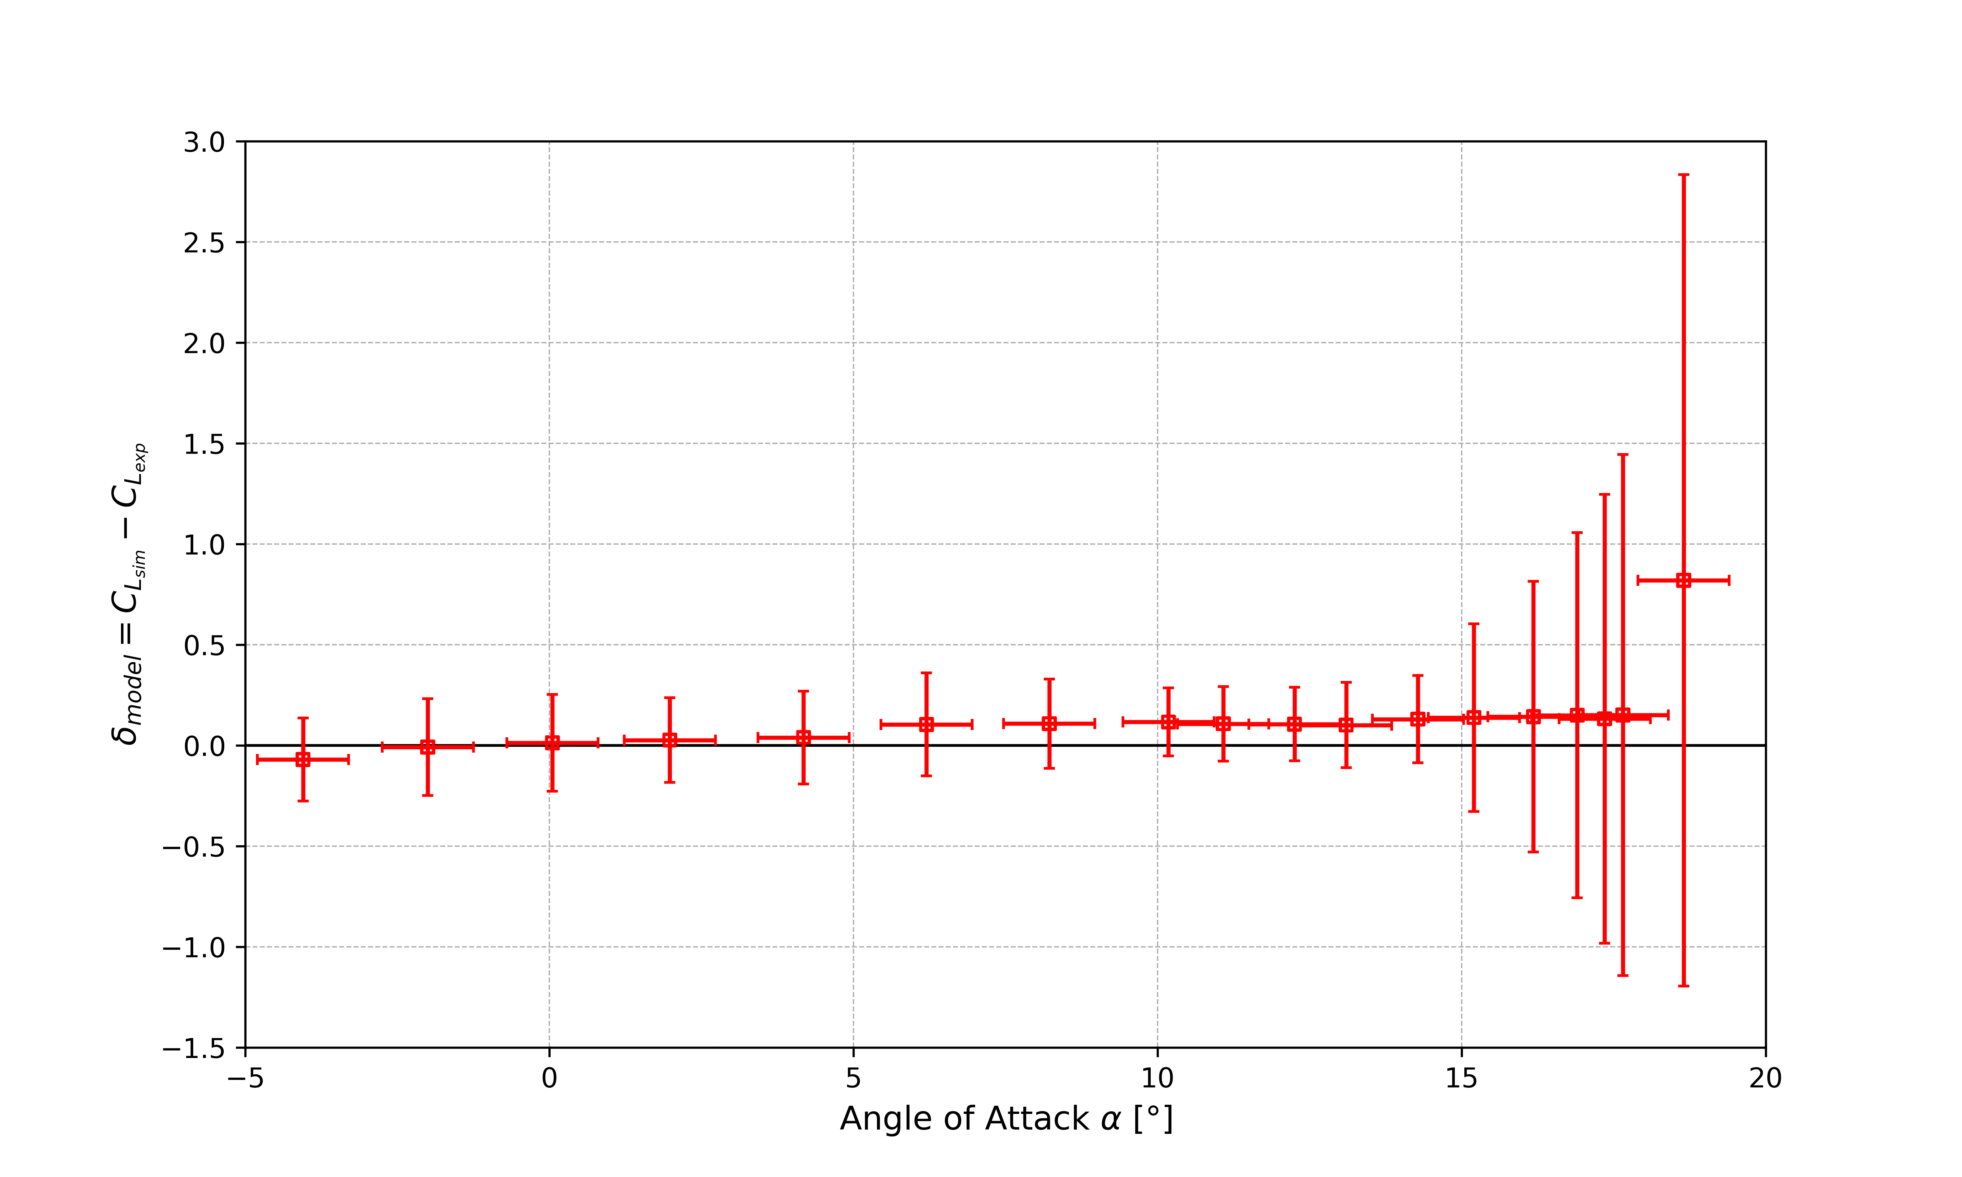
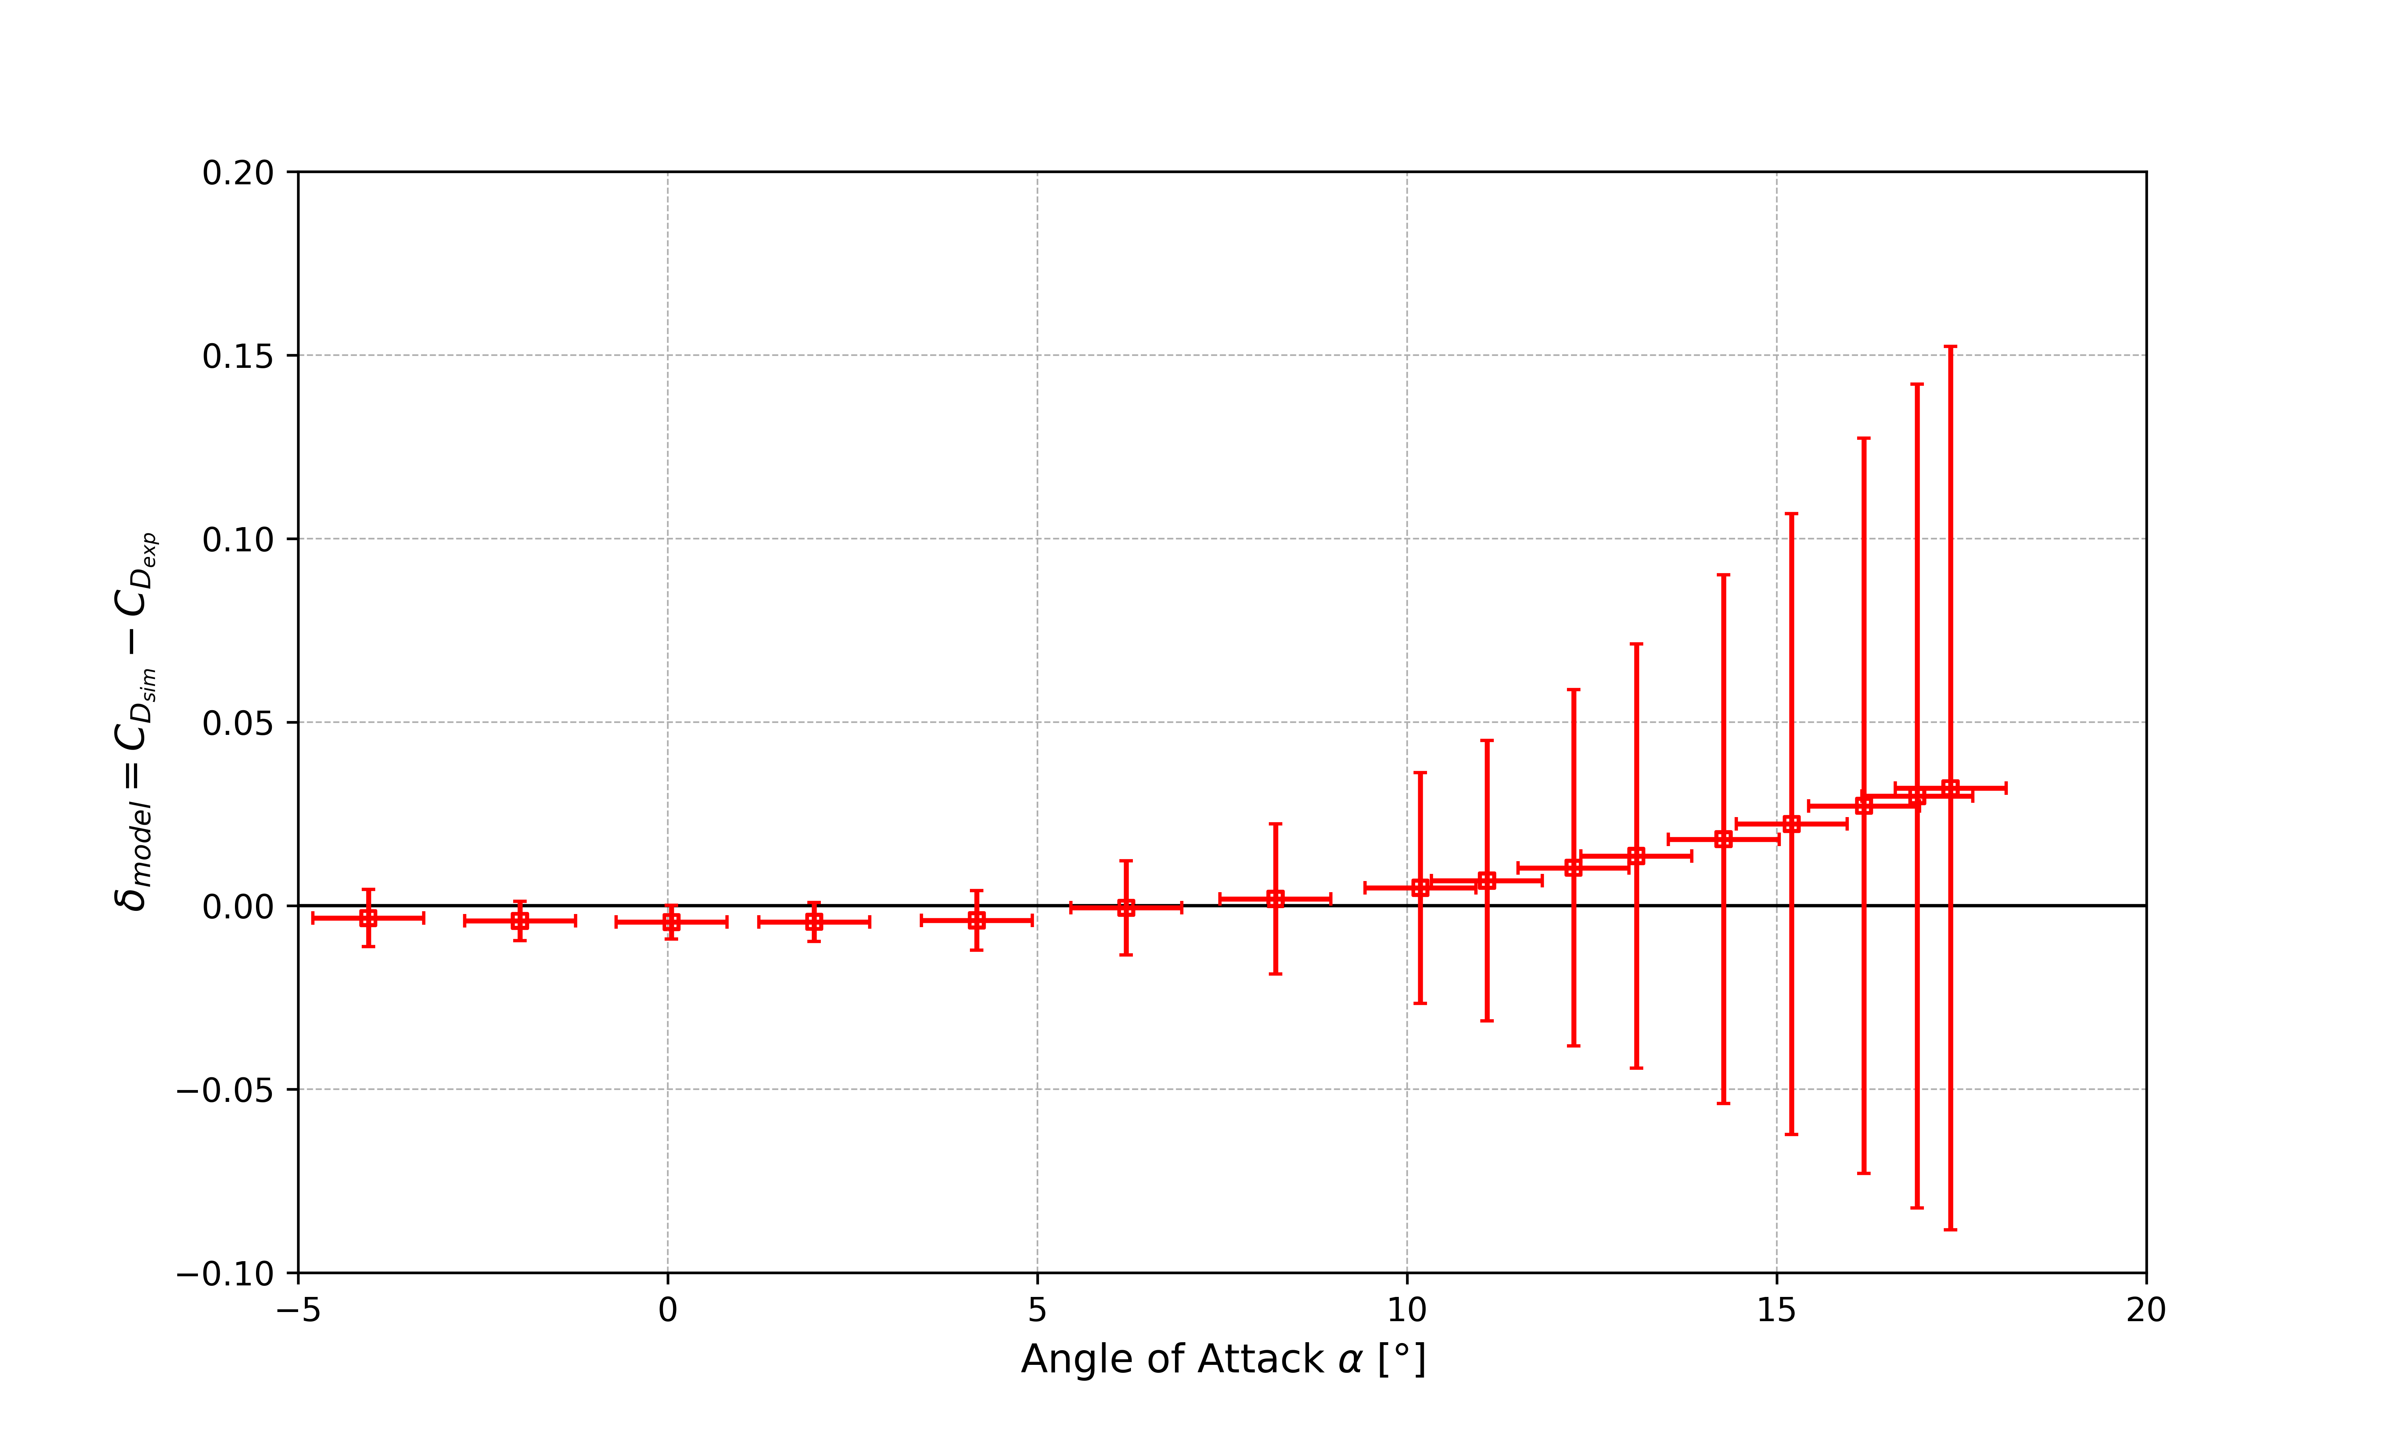
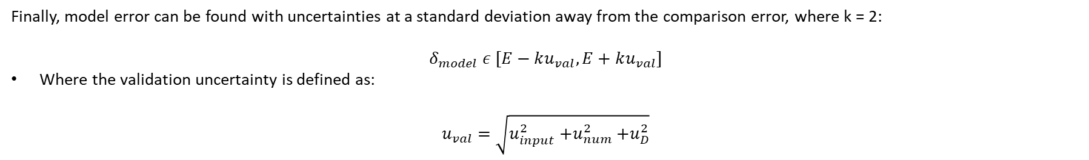
MODEL ERROR – δ_{model}
Finally, model error can be found with uncertainties at a standard deviation away from the comparison error, where k = 2:
$$δ_{model} ε [E−ku_{val}, E+ku_{val}]$$
Where the validation uncertainty is defined as:
$$u_{val}=\sqrt{u_{input}^{2}{+u}_{num}^{2}+u_{D}^{2}}$$

Slide 12
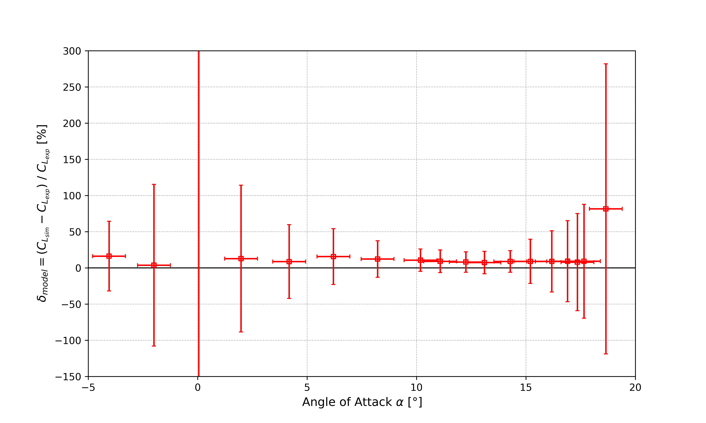
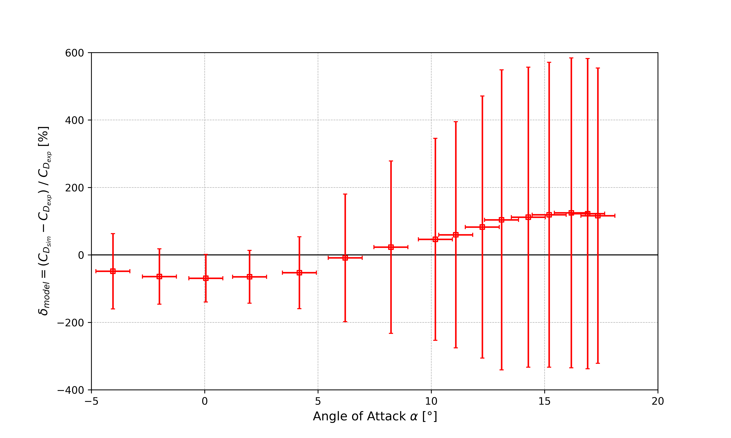
CONTINUED: MODEL ERROR – δ_{model}
Undesirable outcomes are seen across all setpoints for both SRQs. The validation uncertainty is seen to be larger than the comparison error for all setpoints. For the pre-stall setpoints, this can mostly be attributed to lack of rigor on the part of the experimentalist (in reality, it is due to the arbitrarily chosen, hyper-conservative, normal distribution of the input parameters. For example, in hindsight, σ = 0.75° for angle of attack is very extreme). This would have been prevented however, if the Ladson 1988 experimental text contained explicit uncertainties for their experiments’ inputs. For the post-stall setpoints, the large uncertainty can be mostly attributed to numerical uncertainty, where stall is not seen to be captured the same way across grid sizes, leading to an observed order of convergence which greatly differs from the formal order of the utilized Roe scheme.

Slide 13
CONTINUED: MODEL ERROR – δ_{model}
While inconclusive, valuable information can still be extracted from the validation procedure. For certain setpoints, the sign of the model error can almost be inferred, where E is almost larger than u_{val}. For other setpoints, all that can be inferred is the upper limit of the magnitude of δ_{model}
model error , given that u_{val} >> |E|.
The validation procedure would have a more desirable outcome if the following issues could be remedied: propagated input uncertainties with extremely large distributions and differences in capture of stall across grid sizes resulting in large numerical uncertainty.

Slide 14
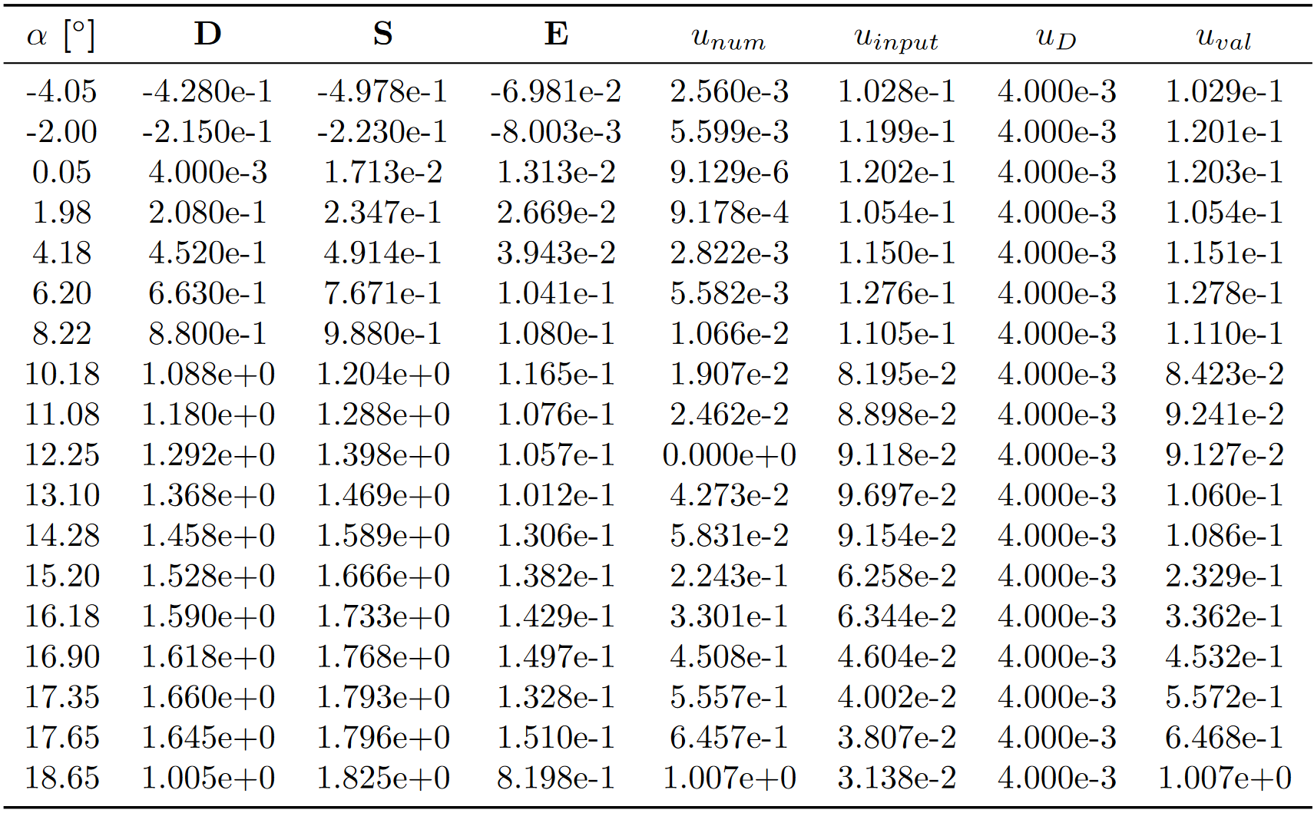
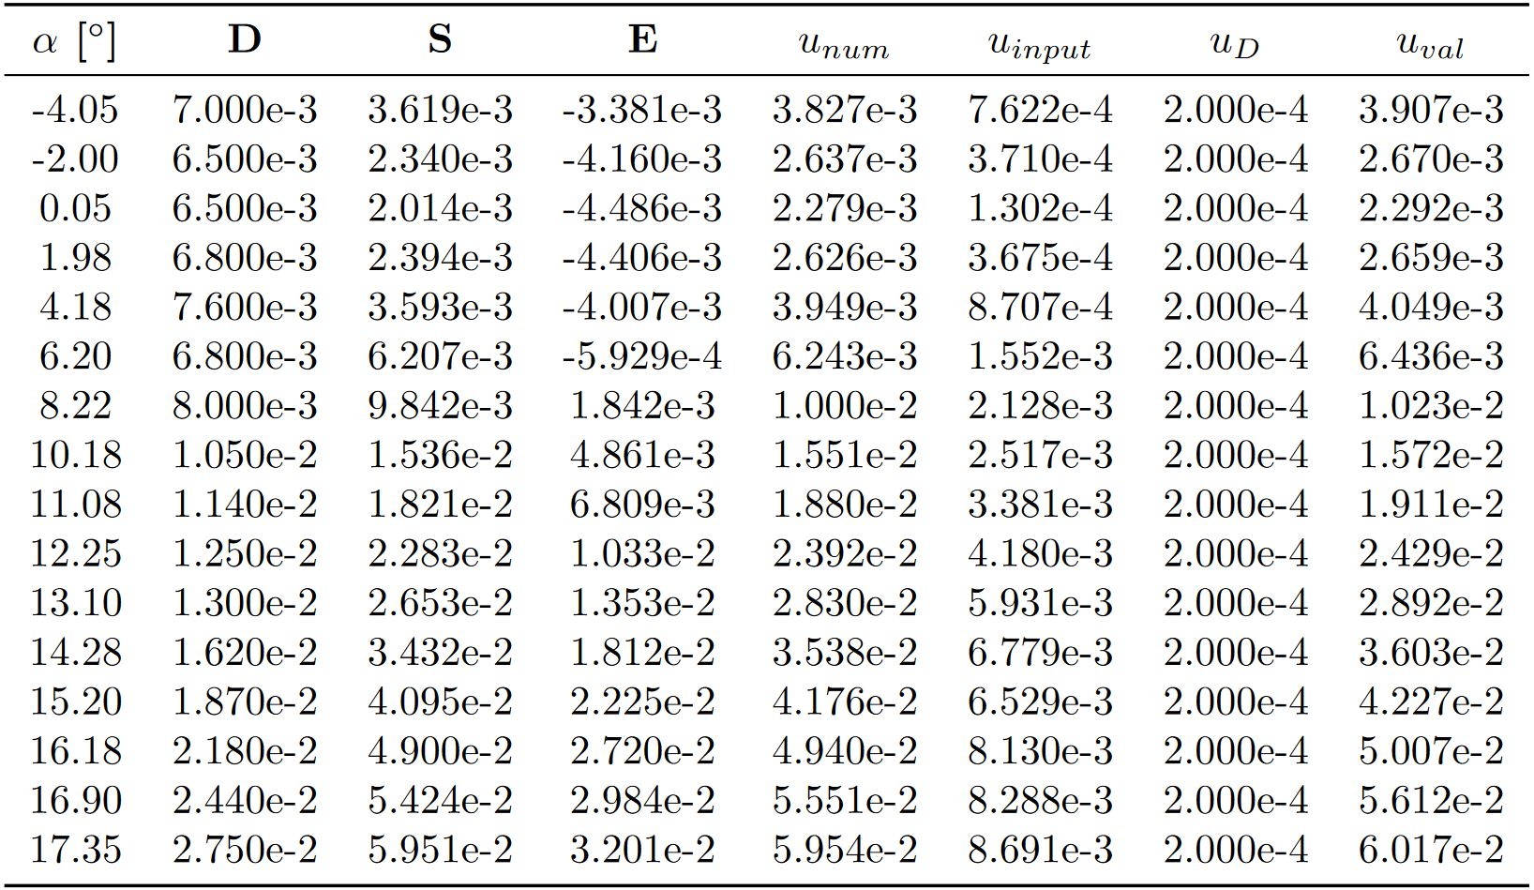
SYNOPSIS
Comparison error and numerical uncertainty increase in function of the setpoint angle of attack. Strangely, the input uncertainty is seen to respectively decrease and increase for C_{L} and C_{D} in function of the setpoint angle of attack. This demonstrates that the C_{D} SRQ is more sensitive to changes in inputs than the C_{L} SRQ. Overall, it is evident that the greatest source of uncertainty is numerical for both C_{L} and C_{D} SRQs.
The usage of a 1st – order spatial scheme can be a possible explanation to the large numerical uncertainty. Typically, 1st – order schemes exhibit a lot of dissipation which may have caused the difficulties seen in capturing stall across grid sizes. Conversely, 2nd – order accurate schemes result in less dissipation and more dispersion, a trade-off which is beneficial in the capture of stall phenomena. The Roe + MUSCL scheme or the JST scheme would most likely lead to a lower numerical uncertainty. Nevertheless, the conducted validation procedure demonstrates that the 1st – order Roe scheme cannot be relied upon with certainty within a confidence interval of 95.4% for this case’s flow conditions.
C_{L}
C_{D}

Slide 15

THANK YOU!

Slide 16
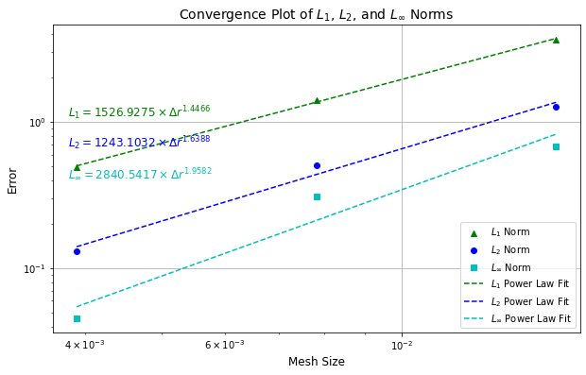
CODE VERIFICATION : CONVERGENCE ANALYSIS
Furthermore, to ensure the correctness of the numerical implementation through the code, we have plotted a convergence behaviour of the numerical simulation performed for different error norms as the mesh size decreases. This plot helps us in analysing how the errors decrease with mesh refinement as shown below. From the plot we can observe that for:
L₁ - error – 1.4466 order of convergence
L₂ - error – 1.6388 order of convergence
L_{inf} - error – 1.9582 order of convergence
The L2 norm error was used for the calculation of observed order of convergence. We can observe the trend of an order of convergence of 1, which is in agreement with the observed order of convergence calculated, and the formal order of convergence observed.

Slide 17
CONTINUED: INPUT UNCERTAINTY – u_{input}
The result of the MCS are mixed aleatory-epistemic distributions given that Re ∈ [5.591, 6.725] × 10⁶. Given the nature of the distributions, a conservative approach is taken to the determination of the input uncertainty for each setpoint. The nominal experimental value for Reynolds number is Re = 5.970 × 10⁶. For each angle of attack setpoint, a MCS with 60 samples is conducted for Re = 5.591 × 10⁶, 5.970 × 10⁶, and 6.725 × 10⁶. Across the 18 measured setpoints, 3240 simulations were conducted in total. The SRQ mean is taken from the Re = 5.970 × 10⁶ MCS, whereas the standard deviations are taken from the lower and upper bounds of the epistemic uncertainty resulting from the range Re ∈ [5.591, 6.725] × 10⁶. The following equation describes the algorithm utilized for determining input uncertainty. Although this approach is conservative, it ensures that the 95.4% confidence interval is respected.
$$u_{input}=\max\left(abs\left(μ_{lower}−μ\right),abs\left(μ_{lower}−μ\right)\right)+max\left(σ_{lower},σ_{upper}\right)$$

Slide 18
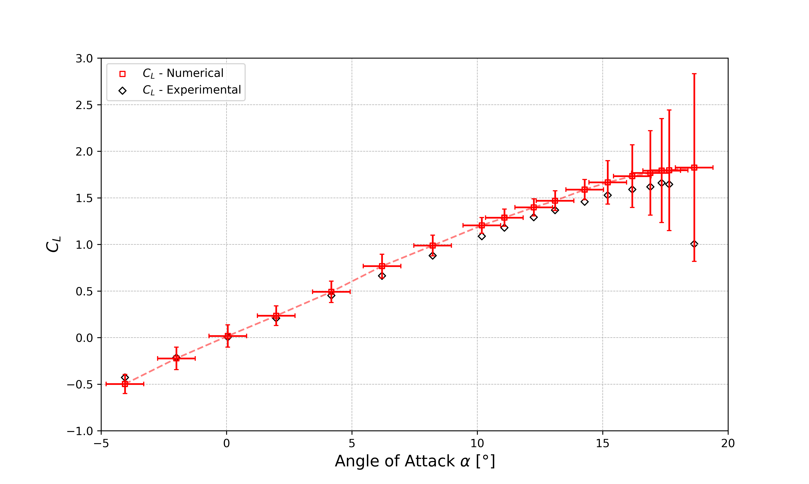
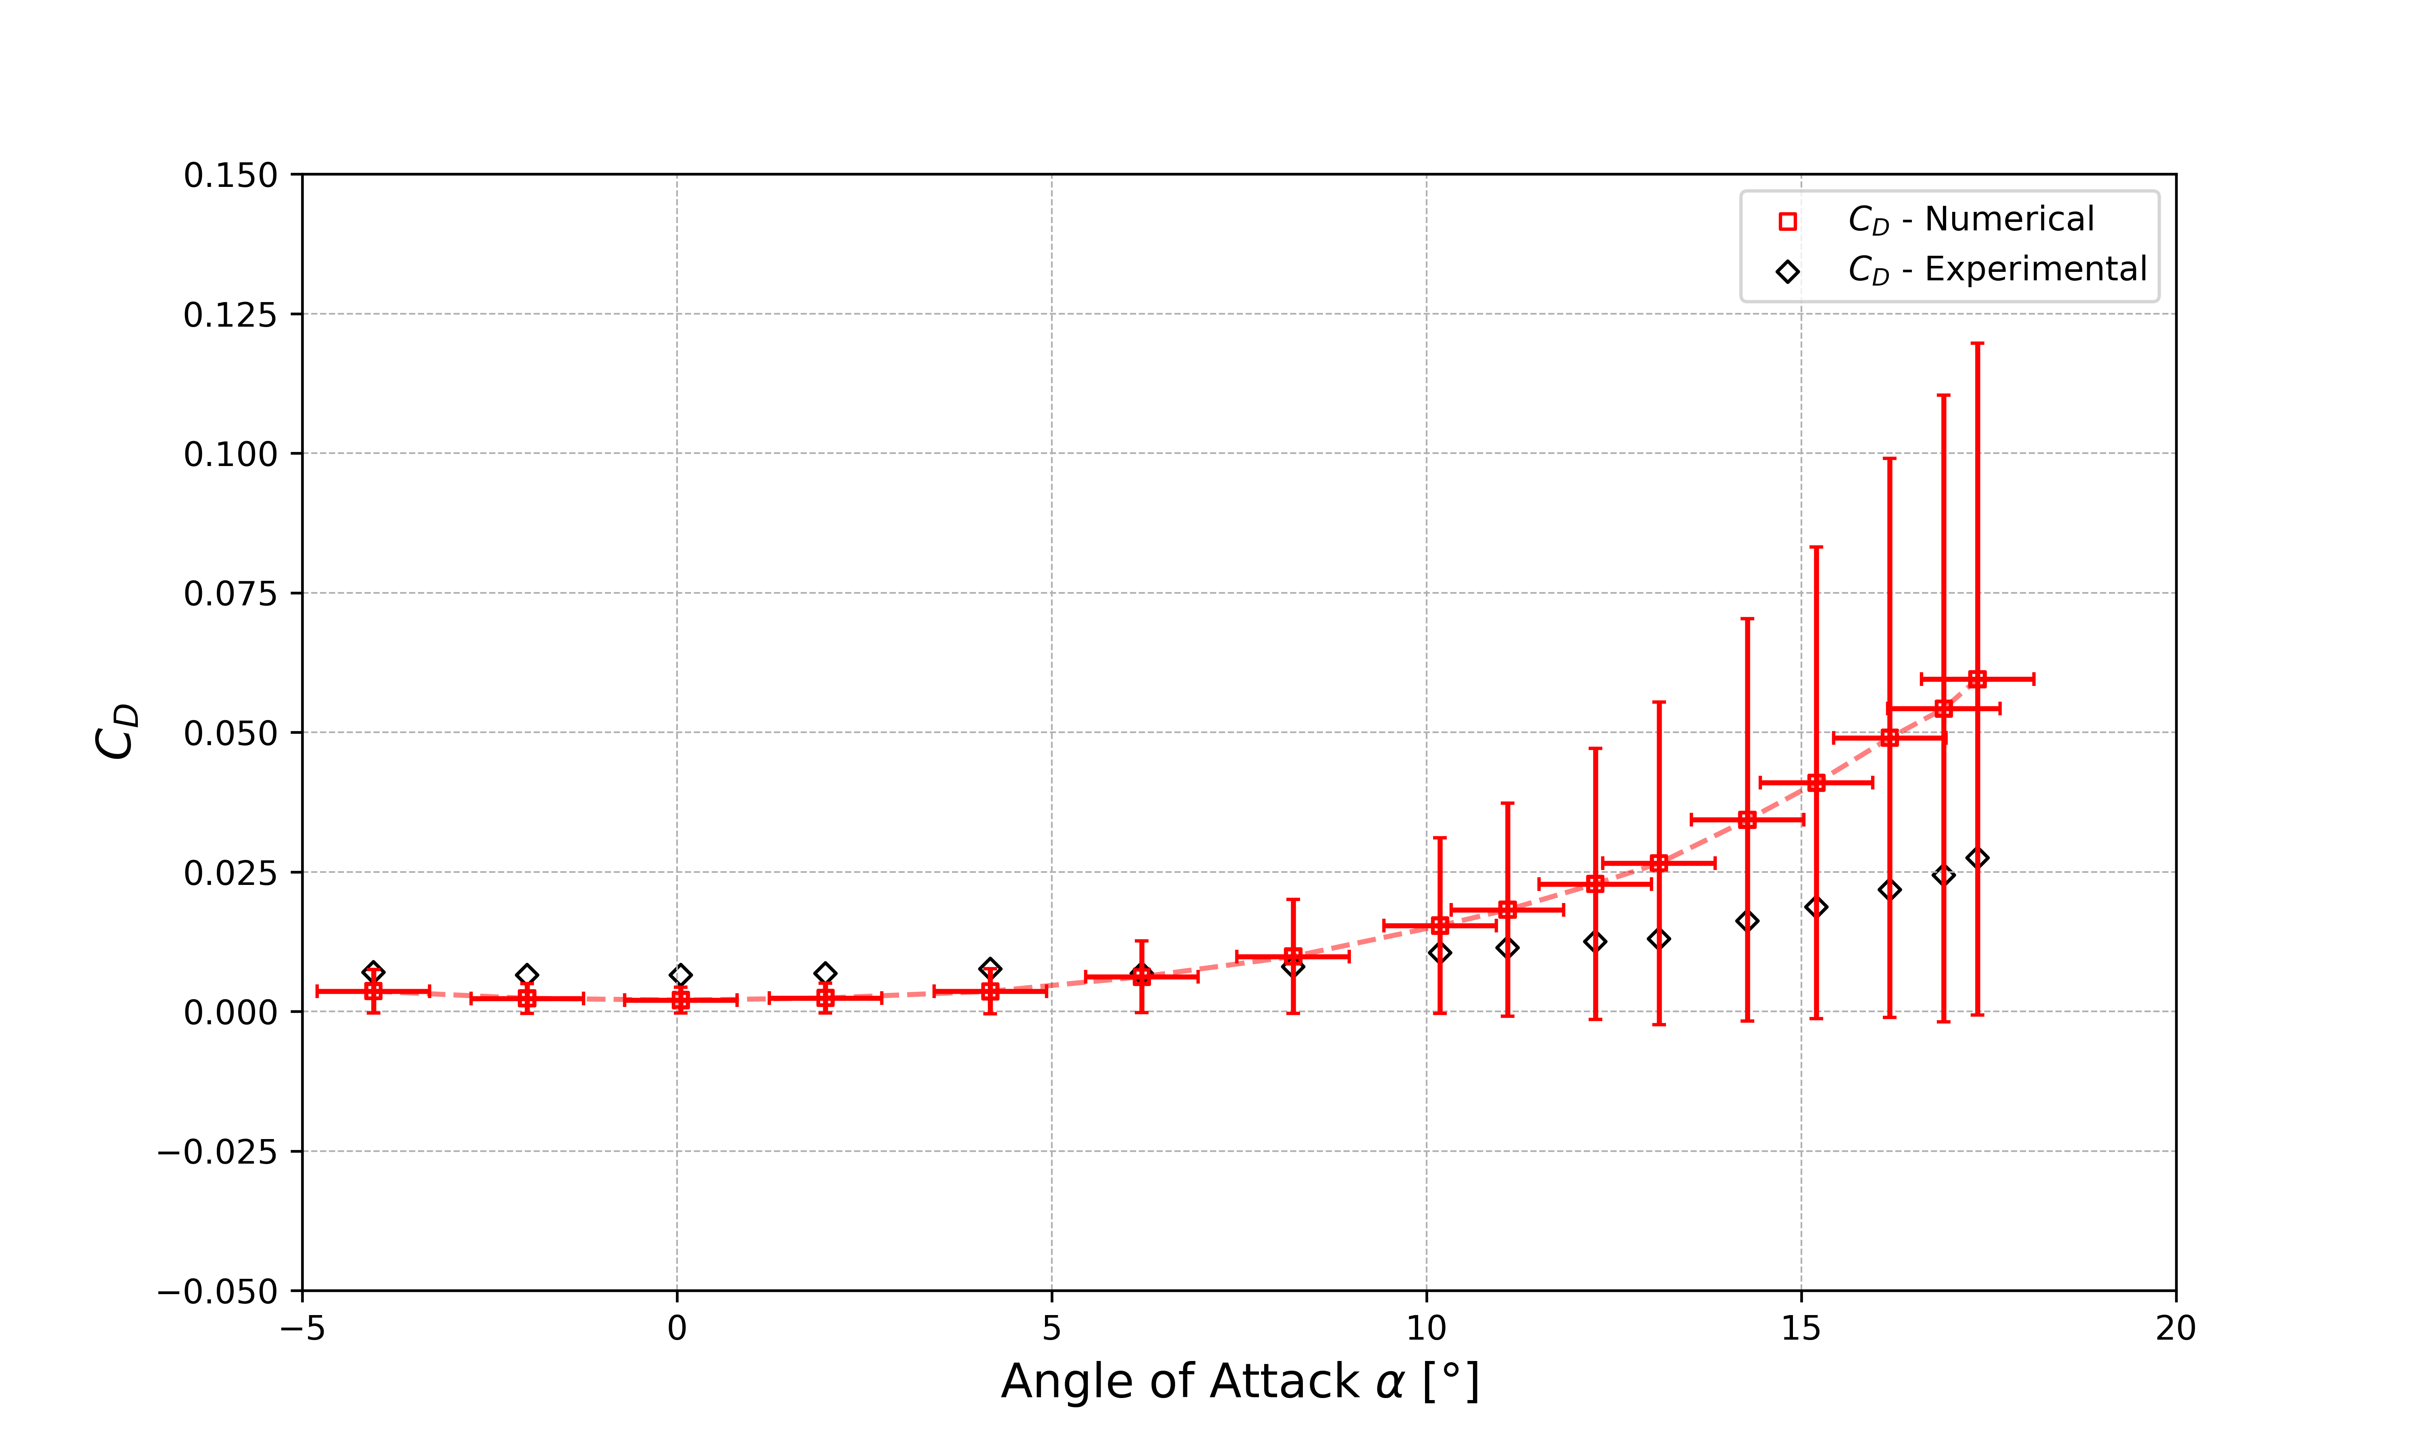
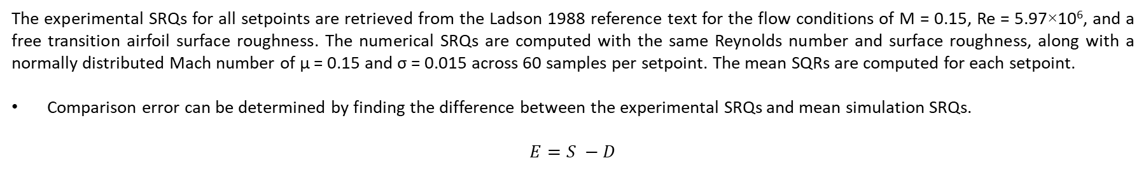
COMPARISON ERROR – E
The experimental SRQs for all setpoints are retrieved from the Ladson 1988 reference text for the flow conditions of M = 0.15, Re = 5.97×10⁶, and a free transition airfoil surface roughness. The numerical SRQs are computed with the same Reynolds number and surface roughness, along with a normally distributed Mach number of μ = 0.15 and σ = 0.015 across 60 samples per setpoint. The mean SQRs are computed for each setpoint.
Comparison error can be determined by finding the difference between the experimental SRQs and mean simulation SRQs.
$$E=S −D$$

Slide 19
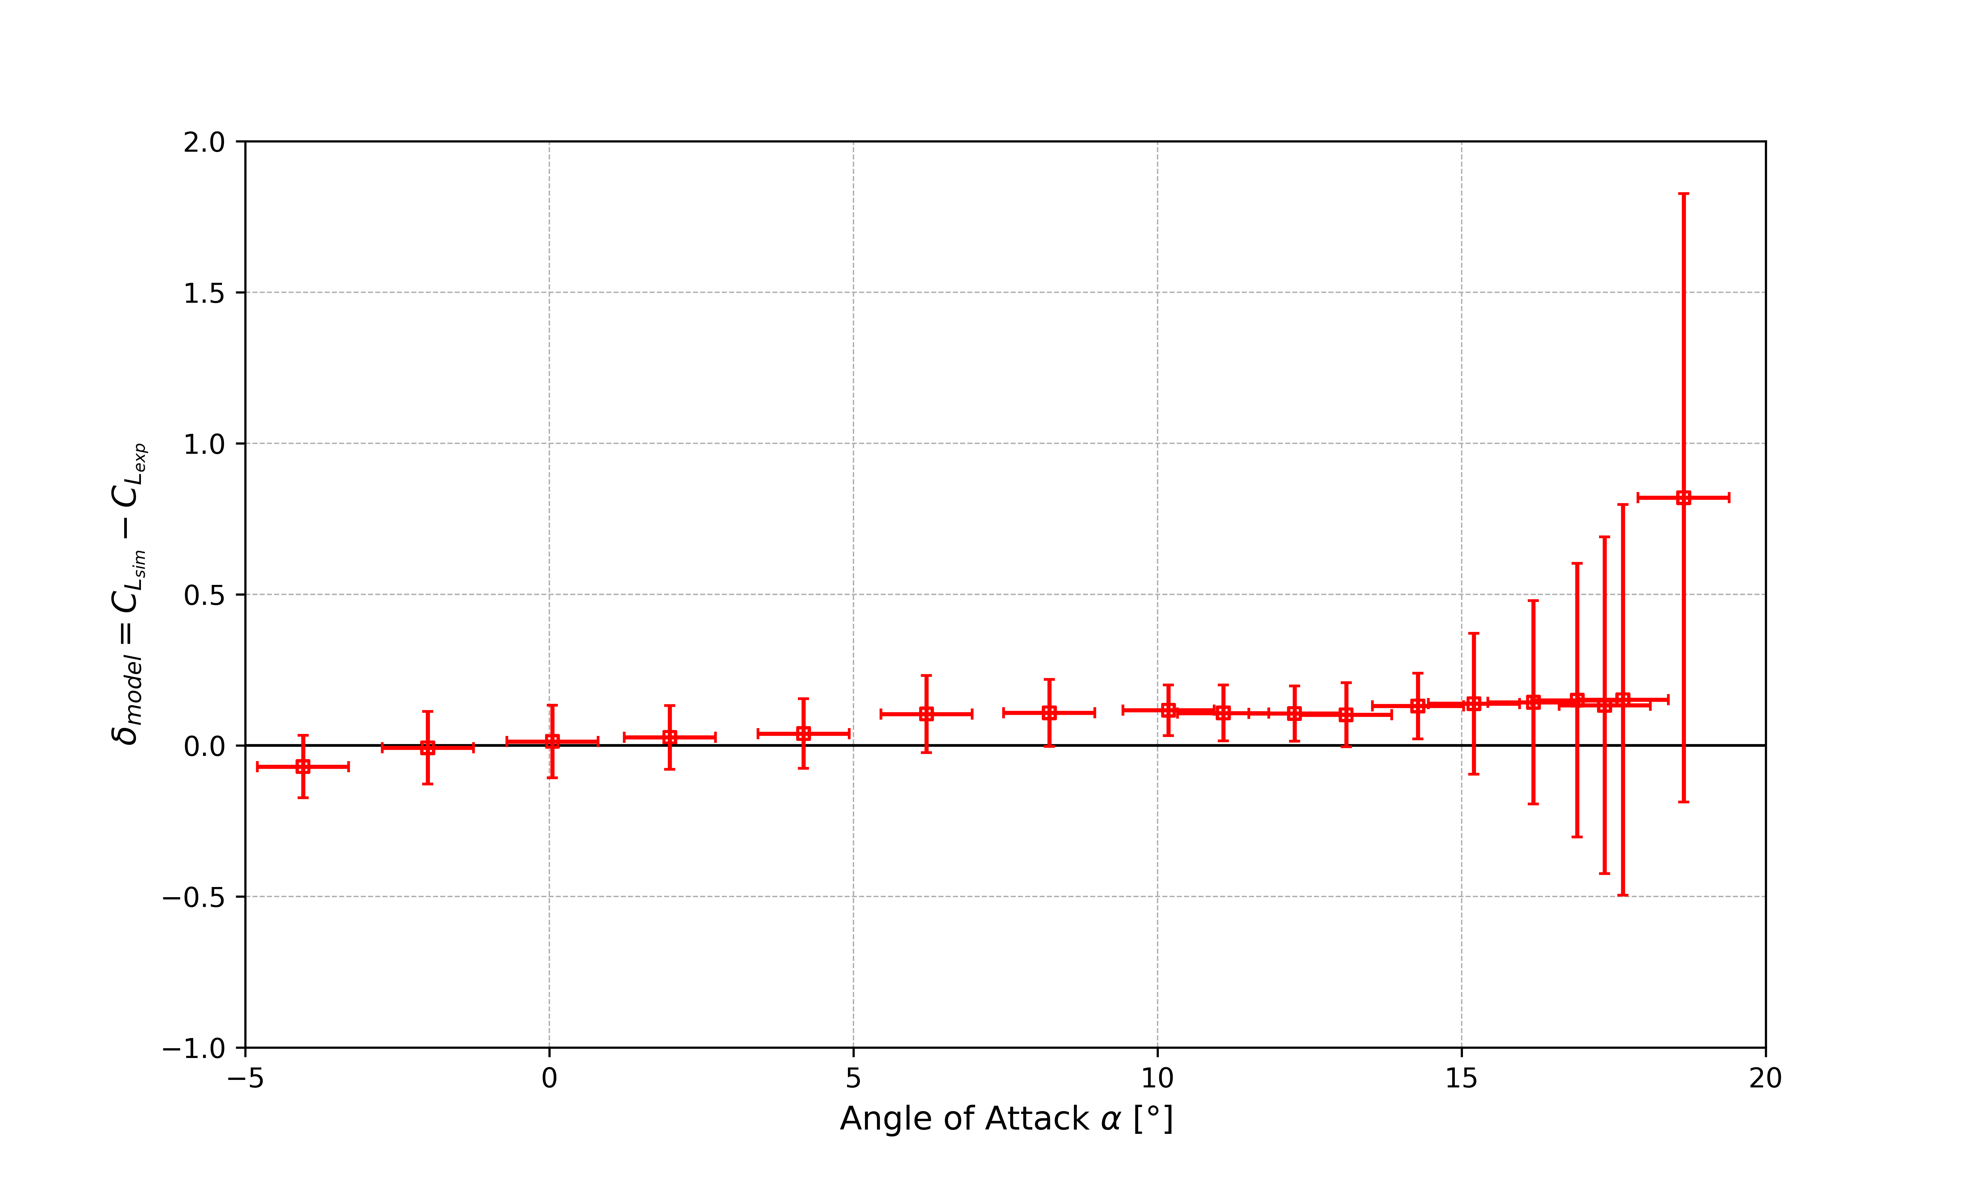
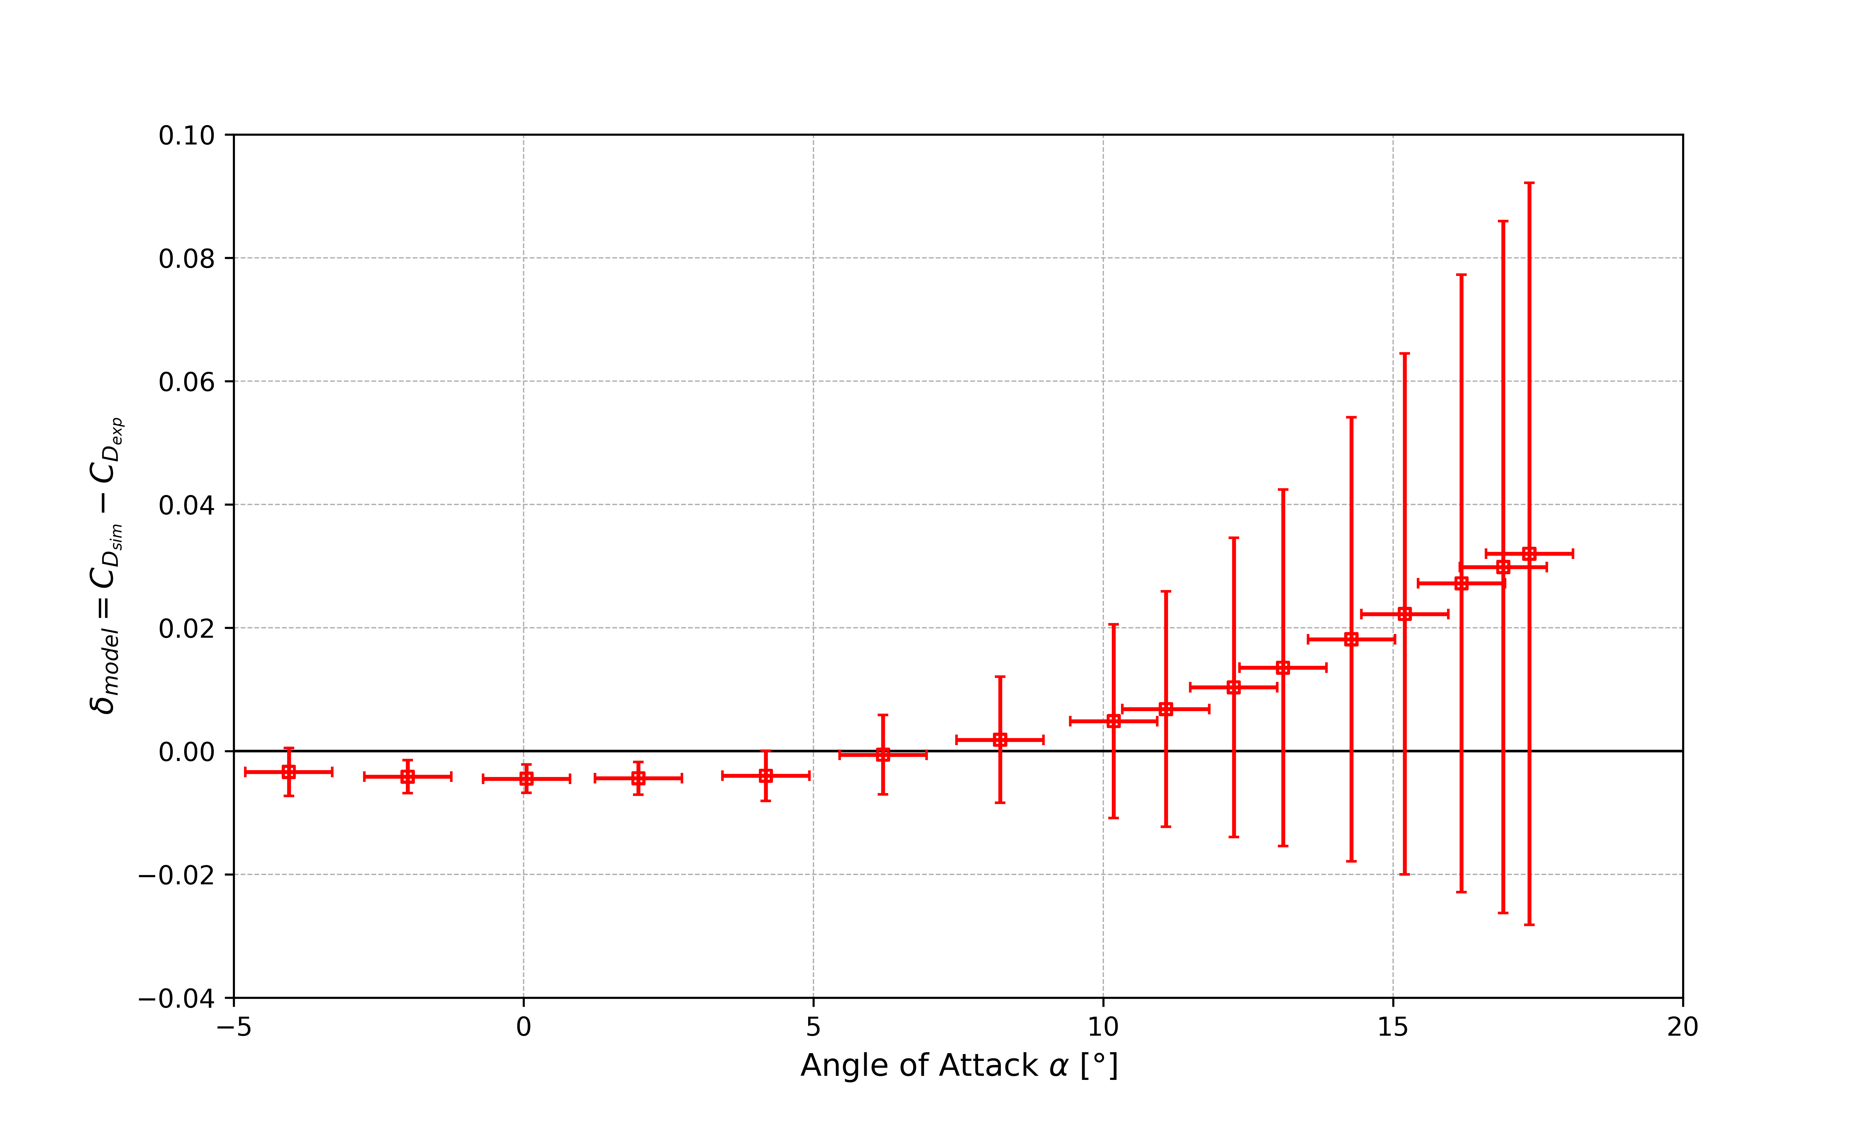
MODEL ERROR – δ_{model}
Finally, model error can be found with uncertainties at a standard deviation away from the comparison error, where k = 2:
$$δ_{model} ε [E−ku_{val}, E+ku_{val}]$$
Where the validation uncertainty is defined as:
$$u_{val}=\sqrt{u_{input}^{2}{+u}_{num}^{2}+u_{D}^{2}}$$

Slide 20
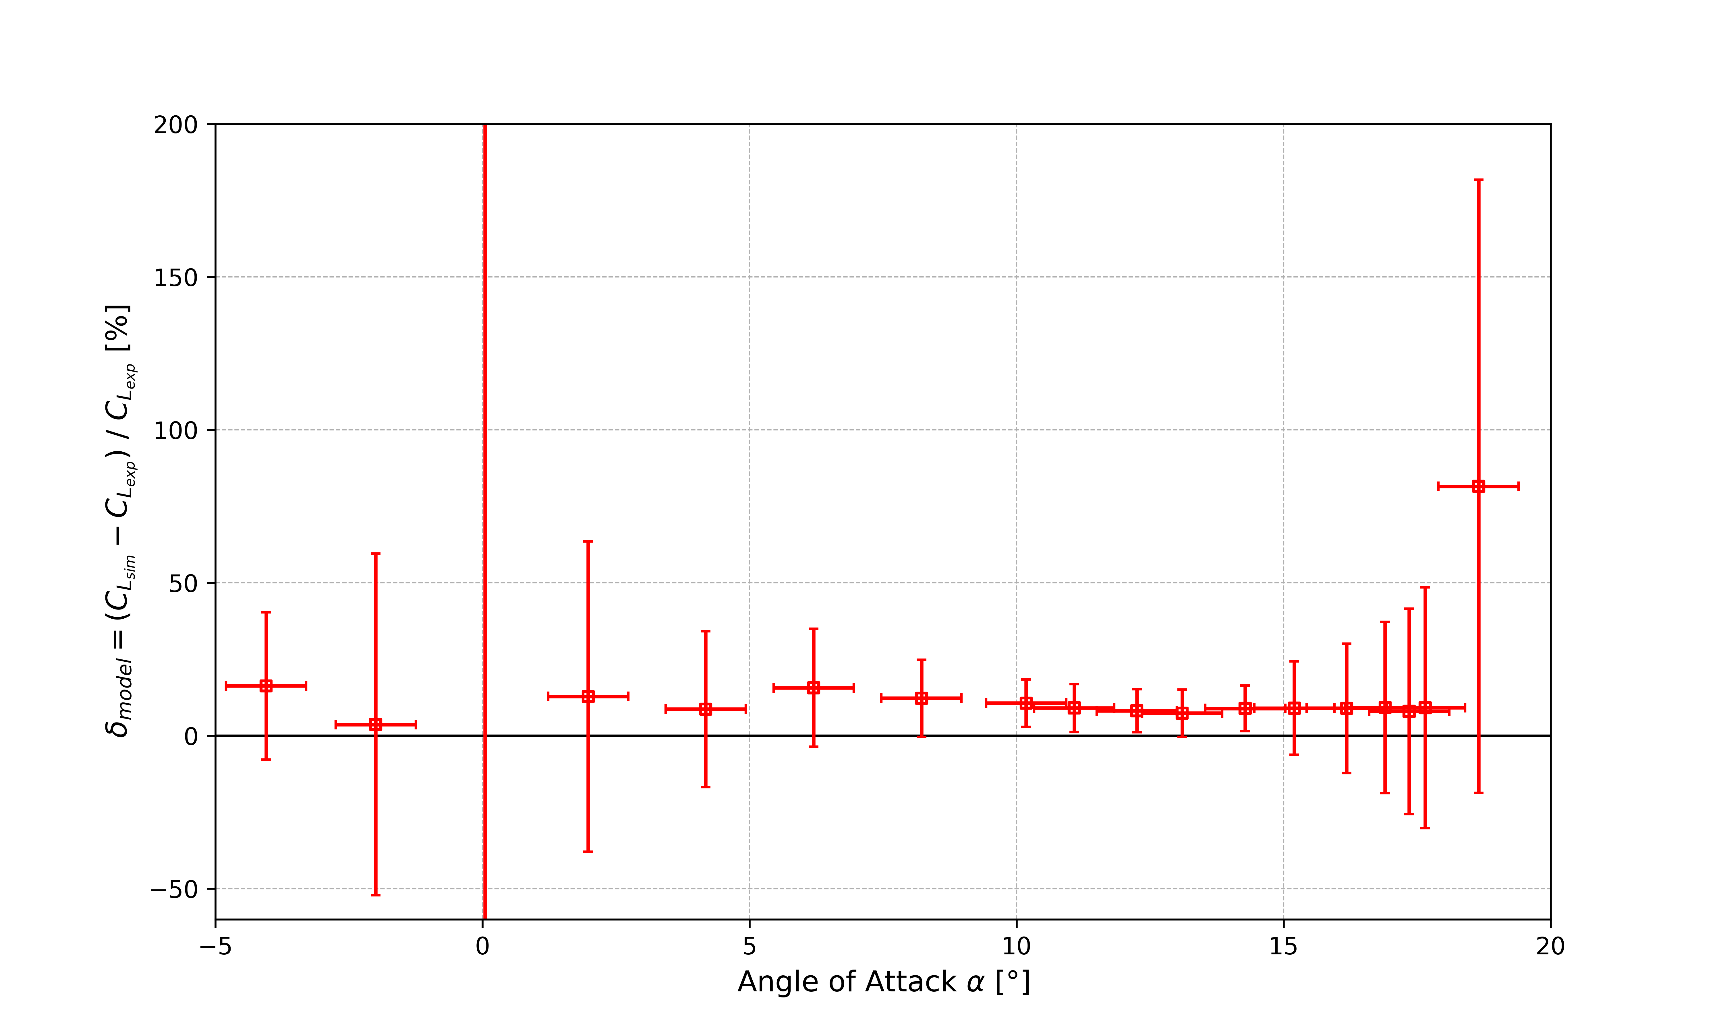
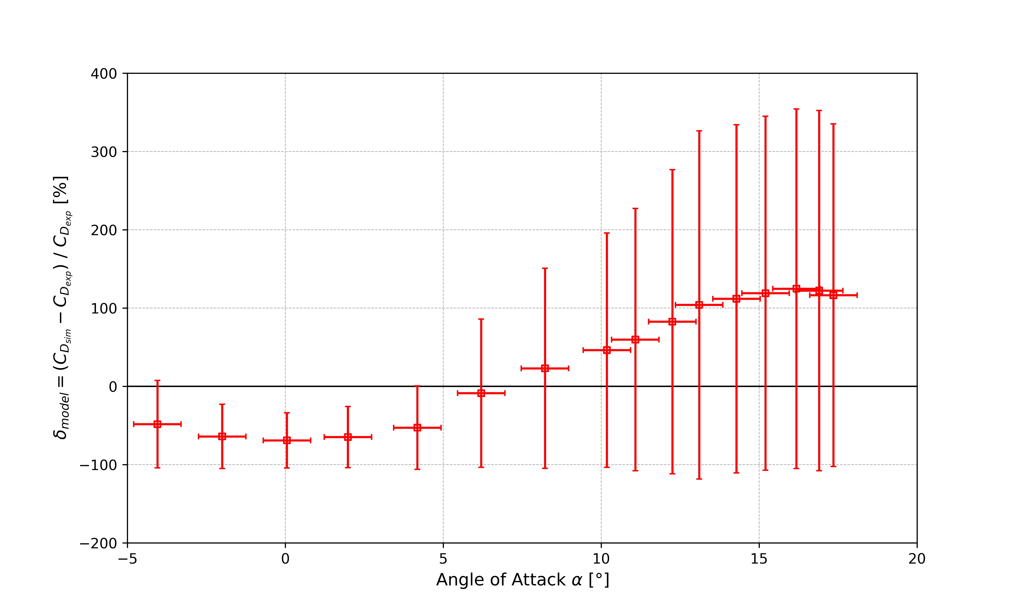
CONTINUED: MODEL ERROR – δ_{model}
Undesirable outcomes are seen across all setpoints for both SRQs. The validation uncertainty is seen to be larger than the comparison error for all setpoints. For the pre-stall setpoints, this can mostly be attributed to lack of rigor on the part of the experimentalist (in reality, it is due to the arbitrarily chosen, hyper-conservative, normal distribution of the input parameters. For example, in hindsight, σ = 0.75° for angle of attack is very extreme). This would have been prevented however, if the Ladson 1988 experimental text contained explicit uncertainties for their experiments’ inputs. For the post-stall setpoints, the large uncertainty can be mostly attributed to numerical uncertainty, where stall is not seen to be captured the same way across grid sizes, leading to an observed order of convergence which greatly differs from the formal order of the utilized Roe scheme.

Slide 21
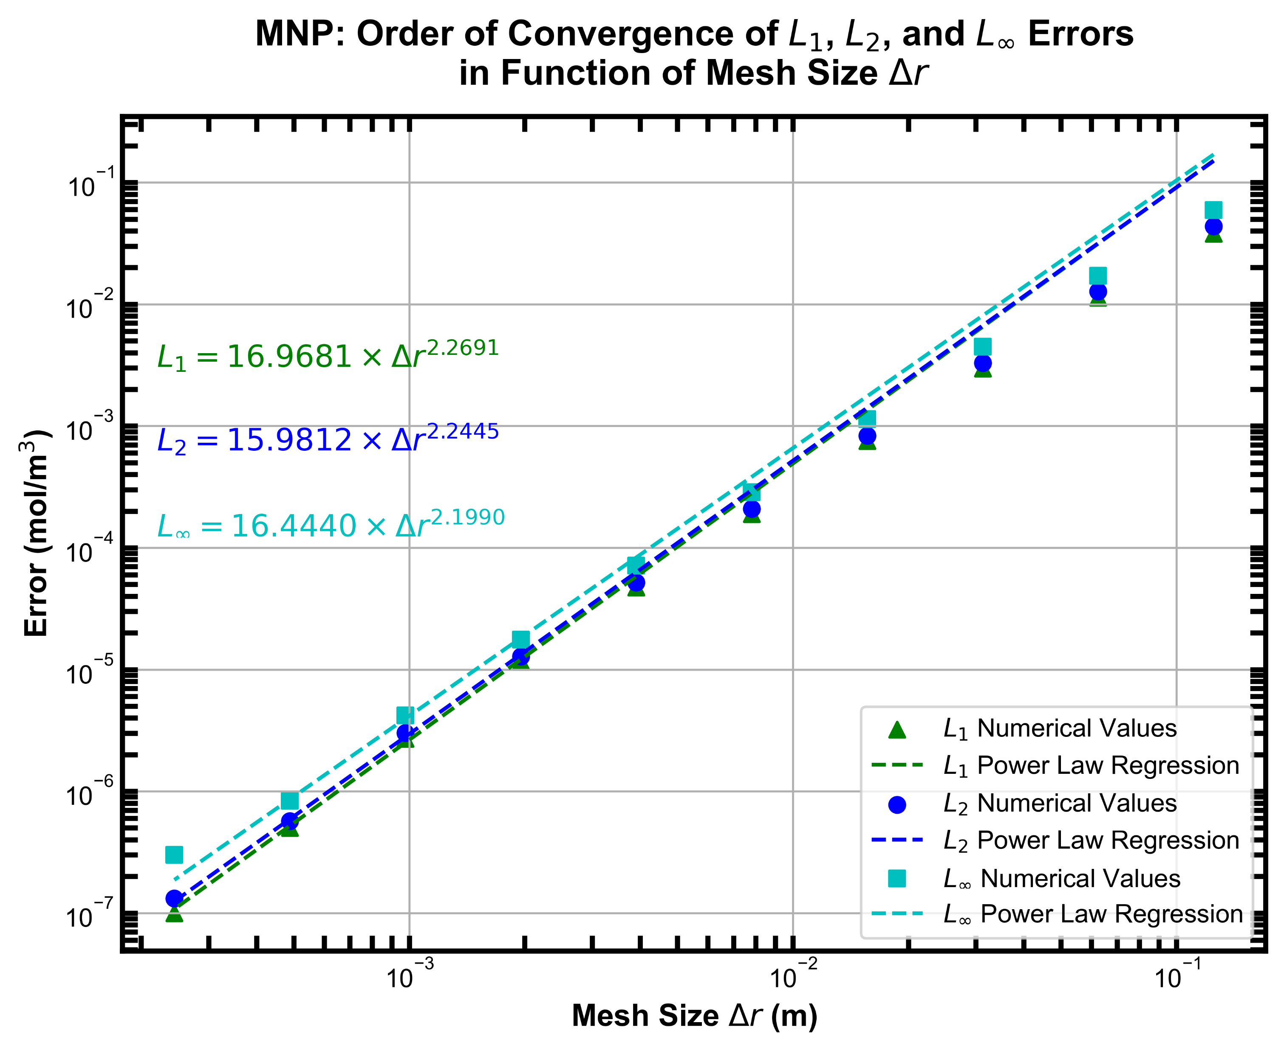
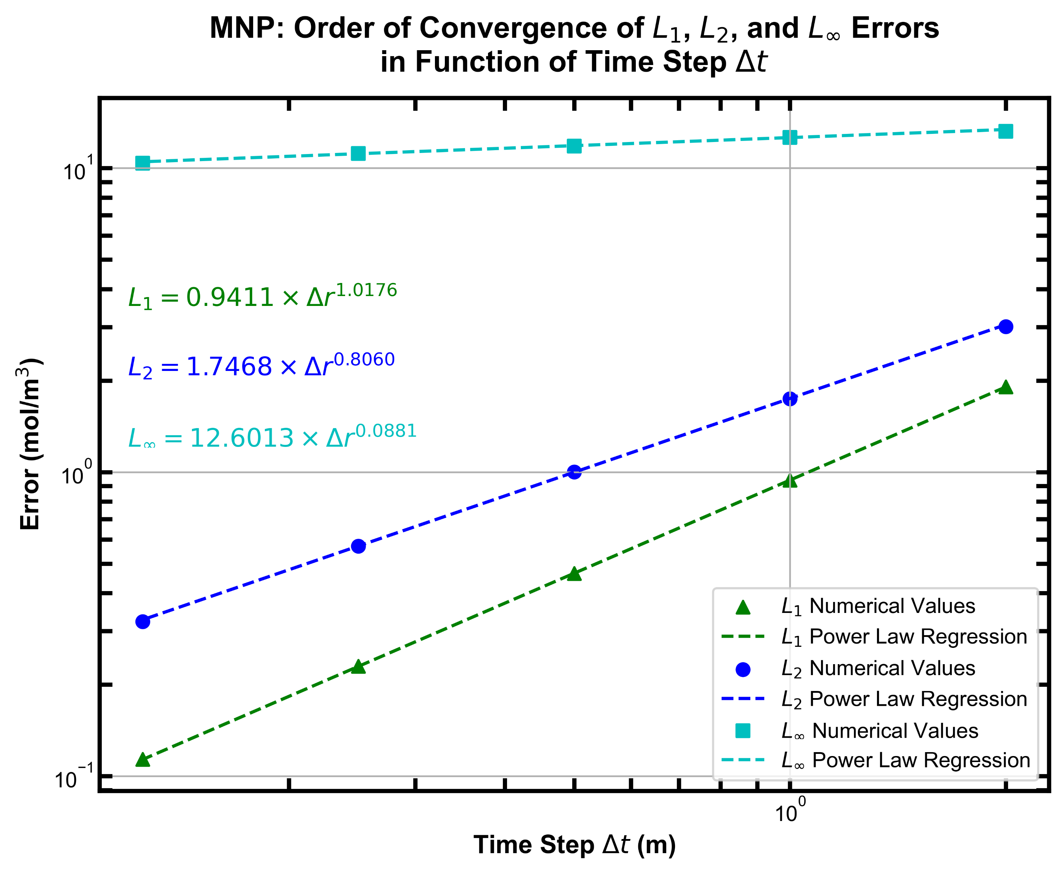
A. CONVERGENCE ANALYSIS – Method of Nearby Problems (MNP)
b. Results and observations
The temporal and spatial convergence analyses resulted in orders of convergence near what was expected, which respectively were a 1st and 2nd order convergence in time and space. The calculated orders of convergence did have a noticeable difference from the expected order of the numerical scheme. This can be attributed to the accuracy of the MNP analysis. The usage of a spline to map the solution space will inherently always bring some form of error. In this case, a 2nd degree bivariate spline was used. The temporal convergence analysis also depicts a very large L∞ error. Our assumption is that this large error came from the first few time steps. Conversely, the large L∞ error is not seen in the spatial convergence analysis as it was conducted much closer to the steady-state, where a 1-D polynomial fit of a nearby problem was used to determine the source term and pseudo-analytical solution.

Slide 22
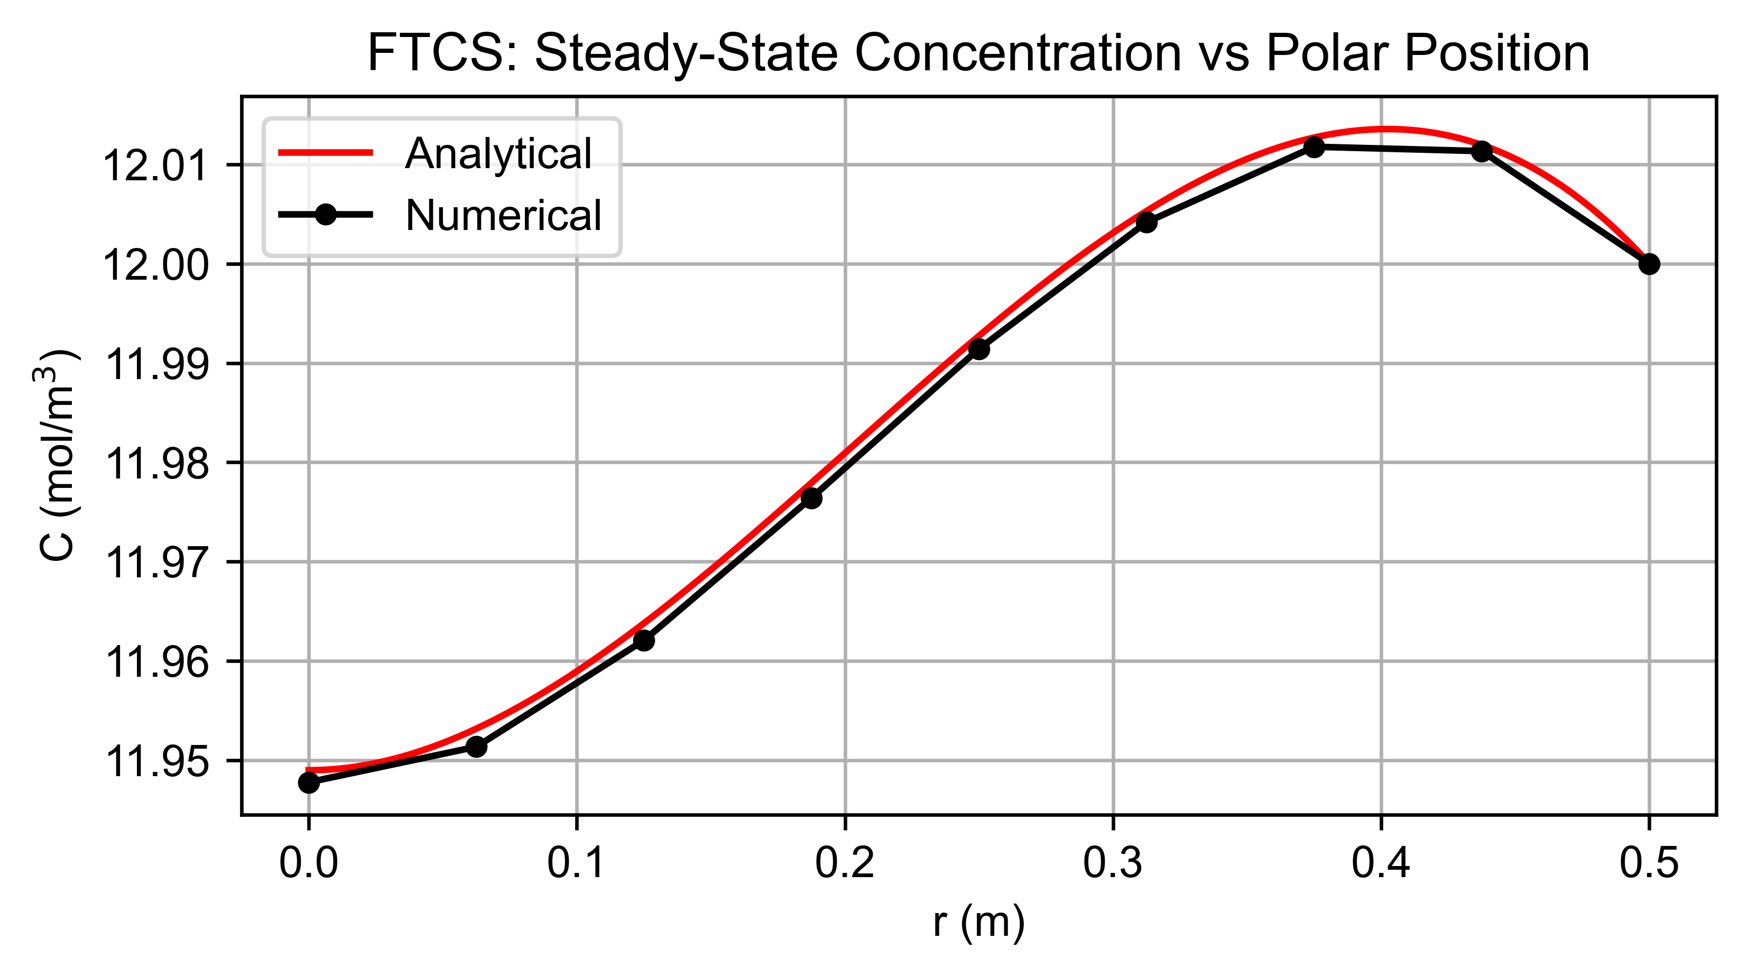
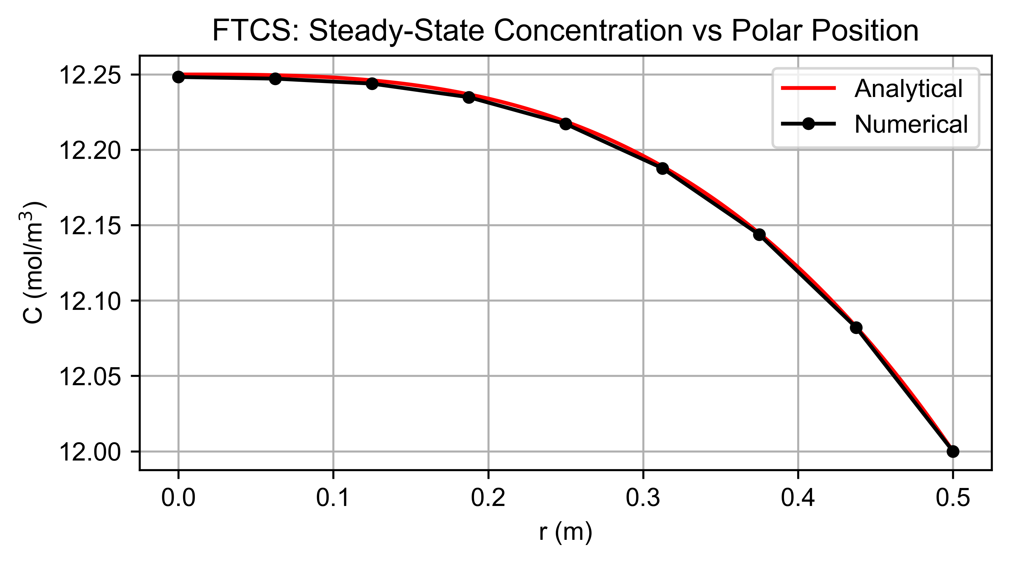
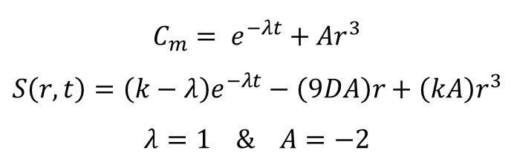
B. CONVERGENCE ANALYSIS – Method of Manufactured Solutions (MMS)
a. Manufactured solution
$$C_{m}= e^{−λt}+Ar^{3}$$
$$S\left(r,t\right)=\left(k−λ\right)e^{−λt}−\left(9DA\right)r+\left(kA\right)r^{3}$$
$$λ=1 \& A=−2$$
D = 10⁻² & k = 4 x 10⁻³
D = 10⁻² & k = 4 x 10⁻⁹

Slide 23
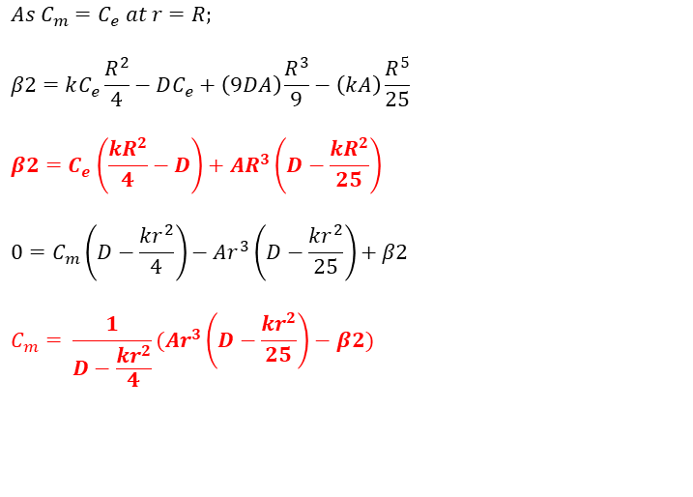
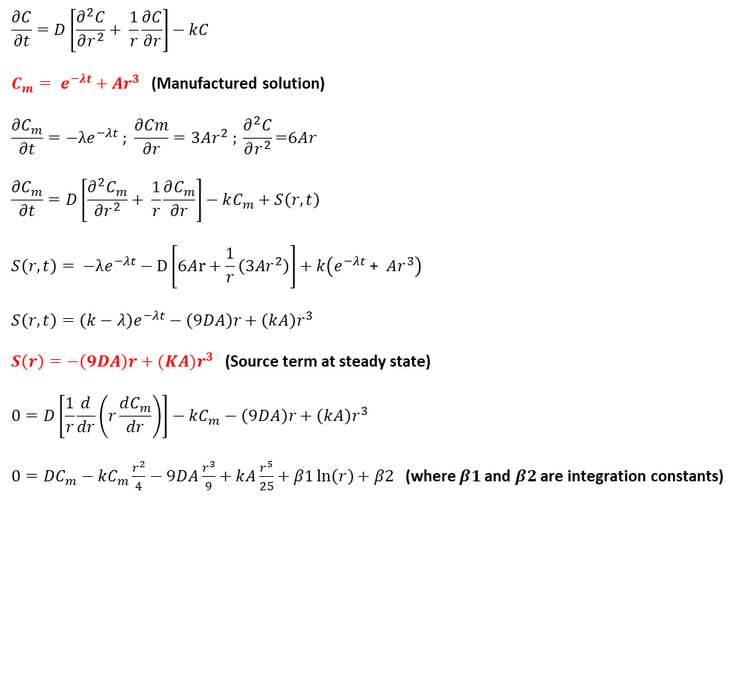
B. CONVERGENCE ANALYSIS – Method of Manufactured Solutions (MMS)
b. Analytical solution with boundary conditions applied
$$\frac{∂C}{∂t}=D\left[\frac{∂^{2}C}{∂r^{2}}+ \frac{1}{r}\frac{∂C}{∂r}\right]−kC$$
$C_{m}= e^{−λt}+Ar^{3}$ (Manufactured solution)
$$\frac{∂C_{m}}{∂t}=−λe^{−λt}\text{ ; }\frac{∂Cm}{∂r}=3Ar^{2} ; \frac{∂^{2}C}{∂r^{2}}\text{=}6Ar$$
$$\frac{∂C_{m}}{∂t}=D\left[\frac{∂^{2}C_{m}}{∂r^{2}}+ \frac{1}{r}\frac{∂C_{m}}{∂r}\right]−kC_{m}+S\left(r,t\right)$$
$$S\left(r,t\right)= −λe^{−λt}−D\left[6Ar+\frac{1}{r}\left(3Ar^{2}\right)\right]+k\left(e^{−λt}\text{ + }{Ar}^{3}\right)$$
$$S\left(r,t\right)=\left(k−λ\right)e^{−λt}−\left(9DA\right)r+\left(kA\right)r^{3}$$
$$S\left(r\right)=−\left(9DA\right)r+(KA)r^{3} \text{(}\text{Source} \text{term} \text{at} \text{steady} \text{state}\text{)}$$
$$0=D\left[\frac{1}{r}\frac{d}{dr}\left(r\frac{dC_{m}}{dr}\right)\right]−kC_{m}−\left(9DA\right)r+\left(kA\right)r^{3}$$
$0=DC_{m}−kC_{m}\frac{r^{2}}{4}−9DA\frac{r^{3}}{9}+kA\frac{r^{5}}{25}+β1\ln\left(r\right)+β2$ (where $β1$ and $β2$are integration constants)
Applying Boundary Conditions
$$As{ C}_{m}=C_{e} at r=R;$$
$$β2=kC_{e}\frac{R^{2}}{4}−DC_{e}+\left(9DA\right)\frac{R^{3}}{9}−\left(kA\right)\frac{R^{5}}{25}$$
$$β2=C_{e}\left(\frac{kR^{2}}{4}−D\right)+AR^{3}\left(D−\frac{kR^{2}}{25}\right)$$
$$0=C_{m}\left(D−\frac{kr^{2}}{4}\right)−Ar^{3}\left(D−\frac{kr^{2}}{25}\right)+β2$$
$$C_{m}= \frac{1}{D−\frac{kr^{2}}{4}}(Ar^{3}\left(D−\frac{kr^{2}}{25}\right)−β2)$$

Slide 24

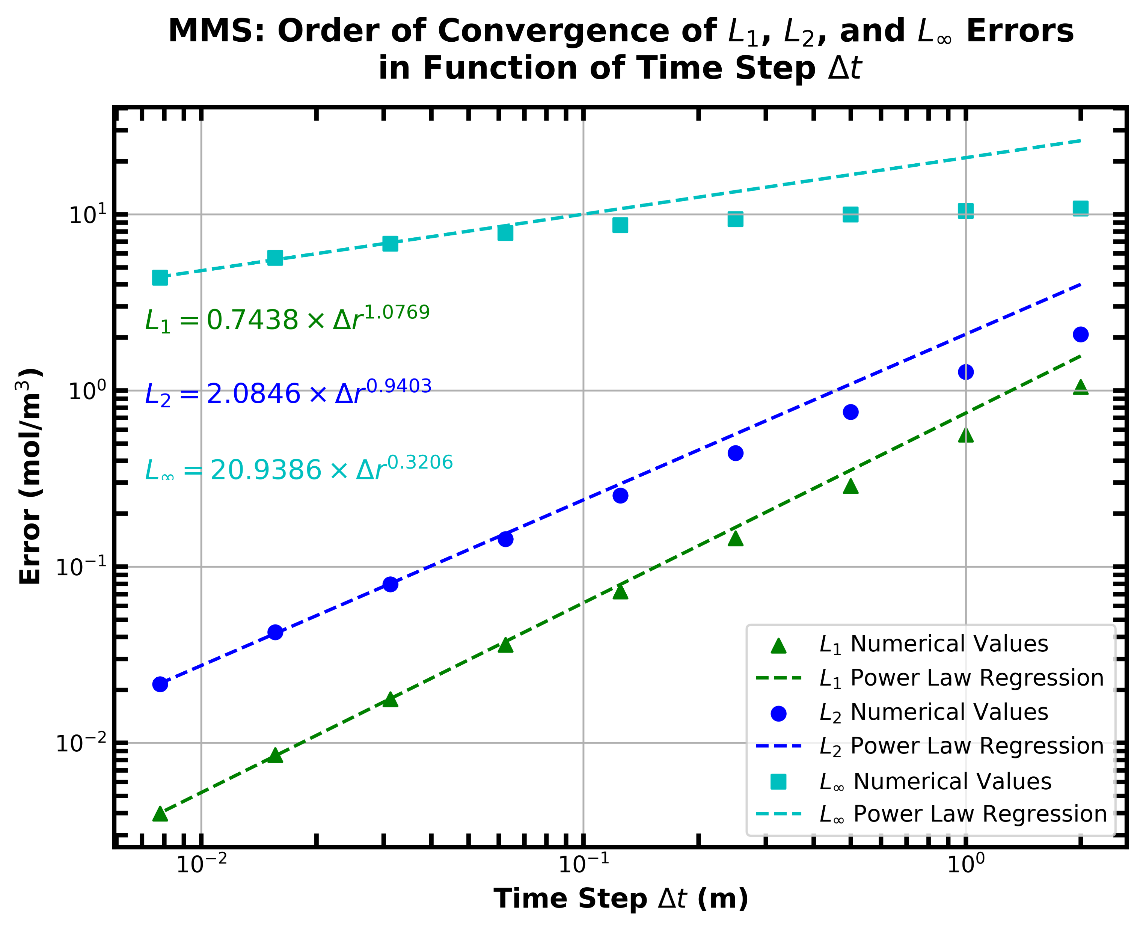
B. CONVERGENCE ANALYSIS – Method of Manufactured Solutions (MMS)
c. Results and observations
The temporal and spatial convergence analyses resulted in orders of convergence very close to what was expected, which respectively were a 1st and 2nd order convergence in time and space. There exists a small noticeable difference between the expected temporal order of the numerical scheme and the order measured in the convergence analysis. This can be attributed to the accuracy of the method through which temporal error was computed. The 2-D solution space was mapped on a 2nd degree bivariate spline to simplify the process of error computation. We acknowledge that the use of a more rigorous method could have led to smaller measured temporal errors. Conversely, the spatial order of convergence falls within ±1% of the numerical scheme’s spatial order. The spatial convergence analysis does not suffer from the same issue as the temporal analysis as the steady-state analytical solution was used as the reference for error computation.

Slide 25
C. CONCLUSION
Comparison between MMS & MNP
It can be concluded that both the MMS and MNP have their benefits and drawbacks.
The MMS is certainly more precise as it does not rely on some form of numerical interpolation to compute the analytical solution and necessary source term.
For the same reason as stated above, the MMS is also less computationally complex and requires less resources.
While being less precise and requiring more computational resources, the MNP has the advantage of being applicable to problems too complex to derive the source term analytically as one would do with the MMS.
With respect to the MNP convergence analysis, the orders of convergence measured with the MMS were significantly closer to the temporal and spatial orders of the numerical scheme. While not measured, the computational time required for the convergence analyses was much larger with the MNP than for the MMS.
Given that a scripting/coding framework for conducting these analyses is already completed, it would be much easier to conduct the MNP on a new problem as the computation of the source term with this method is trivial.

